Slide 1
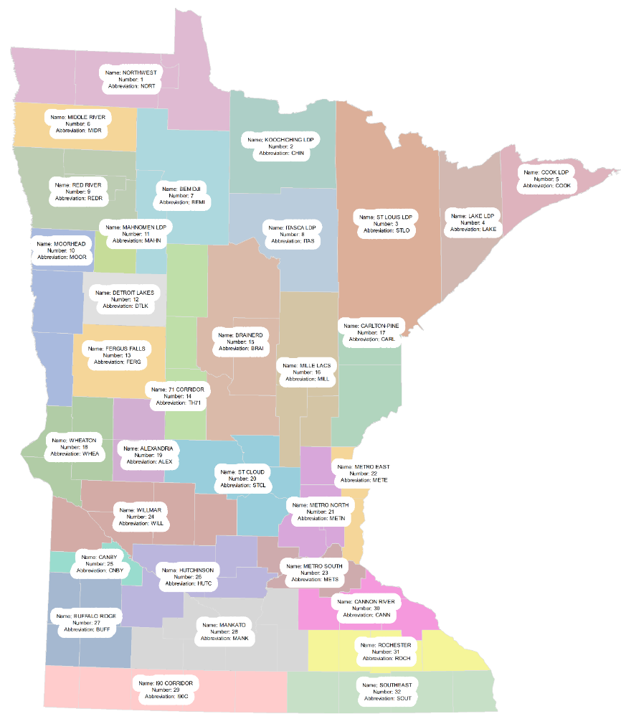
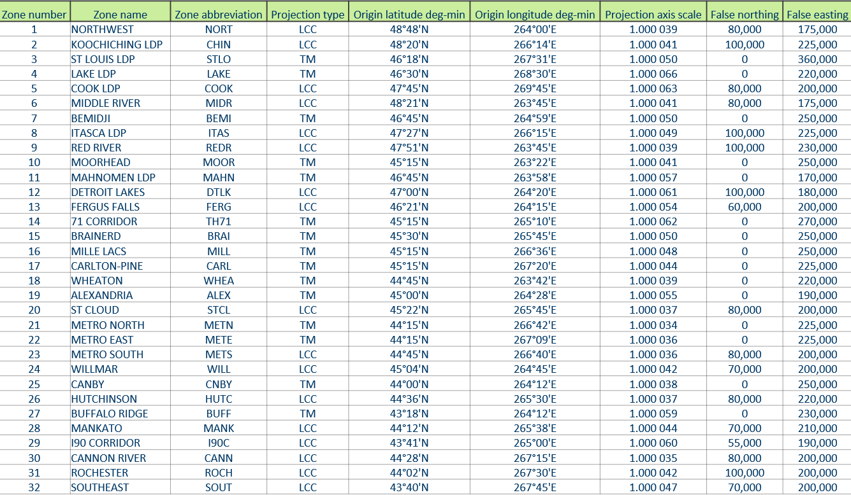
Preliminary Maps and Parameters
Geoff Bitner, LS
MnDOT Office of Land Management
NGS State Geodetic Coordinator
MACS Land Surveying Seminar
October 22, 2021 | St. Cloud, MN

Slide 2
Preliminary Parameters version March 2021
Zone number | Zone name | Zone abbreviation | Projection type | Origin latitude deg-min | Origin longitude deg-min | Projection axis scale | False northing | False easting
1 | NORTHWEST | NORT | LCC | 48°48'N | 264°00'E | 1.000 039 | 80,000 | 175,000
2 | KOOCHICHING LDP | CHIN | LCC | 48°20'N | 266°14'E | 1.000 041 | 100,000 | 225,000
3 | ST LOUIS LDP | STLO | TM | 46°18'N | 267°31'E | 1.000 050 | 0 | 360,000
4 | LAKE LDP | LAKE | TM | 46°30'N | 268°30'E | 1.000 066 | 0 | 220,000
5 | COOK LDP | COOK | LCC | 47°45'N | 269°45'E | 1.000 063 | 80,000 | 200,000
6 | MIDDLE RIVER | MIDR | LCC | 48°21'N | 263°45'E | 1.000 041 | 80,000 | 175,000
7 | BEMIDJI | BEMI | TM | 46°45'N | 264°59'E | 1.000 050 | 0 | 250,000
8 | ITASCA LDP | ITAS | LCC | 47°27'N | 266°15'E | 1.000 049 | 100,000 | 225,000
9 | RED RIVER | REDR | LCC | 47°51'N | 263°45'E | 1.000 039 | 100,000 | 230,000
10 | MOORHEAD | MOOR | TM | 45°15'N | 263°22'E | 1.000 041 | 0 | 250,000
11 | MAHNOMEN LDP | MAHN | TM | 46°45'N | 263°58'E | 1.000 057 | 0 | 170,000
12 | DETROIT LAKES | DTLK | LCC | 47°00'N | 264°20'E | 1.000 061 | 100,000 | 180,000
13 | FERGUS FALLS | FERG | LCC | 46°21'N | 264°15'E | 1.000 054 | 60,000 | 200,000
14 | 71 CORRIDOR | TH71 | TM | 45°15'N | 265°10'E | 1.000 062 | 0 | 270,000
15 | BRAINERD | BRAI | TM | 45°30'N | 265°45'E | 1.000 050 | 0 | 250,000
16 | MILLE LACS | MILL | TM | 45°15'N | 266°36'E | 1.000 048 | 0 | 250,000
17 | CARLTON-PINE | CARL | TM | 45°15'N | 267°20'E | 1.000 044 | 0 | 225,000
18 | WHEATON | WHEA | TM | 44°45'N | 263°42'E | 1.000 039 | 0 | 220,000
19 | ALEXANDRIA | ALEX | TM | 45°00'N | 264°28'E | 1.000 055 | 0 | 190,000
20 | ST CLOUD | STCL | LCC | 45°22'N | 265°45'E | 1.000 037 | 80,000 | 200,000
21 | METRO NORTH | METN | TM | 44°15'N | 266°42'E | 1.000 034 | 0 | 225,000
22 | METRO EAST | METE | TM | 44°15'N | 267°09'E | 1.000 036 | 0 | 225,000
23 | METRO SOUTH | METS | LCC | 44°45'N | 266°40'E | 1.000 036 | 80,000 | 200,000
24 | WILLMAR | WILL | LCC | 45°04'N | 264°45'E | 1.000 042 | 70,000 | 200,000
25 | CANBY | CNBY | TM | 44°00'N | 264°12'E | 1.000 038 | 0 | 250,000
26 | HUTCHINSON | HUTC | LCC | 44°36'N | 265°30'E | 1.000 037 | 80,000 | 220,000
27 | BUFFALO RIDGE | BUFF | TM | 43°18'N | 264°12'E | 1.000 059 | 0 | 230,000
28 | MANKATO | MANK | LCC | 44°12'N | 265°38'E | 1.000 044 | 70,000 | 210,000
29 | I90 CORRIDOR | I90C | LCC | 43°41'N | 265°00'E | 1.000 060 | 55,000 | 190,000
30 | CANNON RIVER | CANN | LCC | 44°28'N | 267°15'E | 1.000 035 | 80,000 | 200,000
31 | ROCHESTER | ROCH | LCC | 44°02'N | 267°30'E | 1.000 042 | 100,000 | 200,000
32 | SOUTHEAST | SOUT | LCC | 43°40'N | 267°45'E | 1.000 047 | 70,000 | 200,000

Slide 3
Map of Zone Names

Slide 4
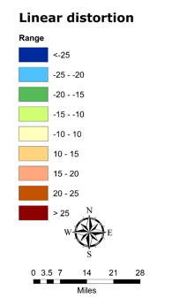
Kittson, Roseau, and Lake of the Woods

Slide 5
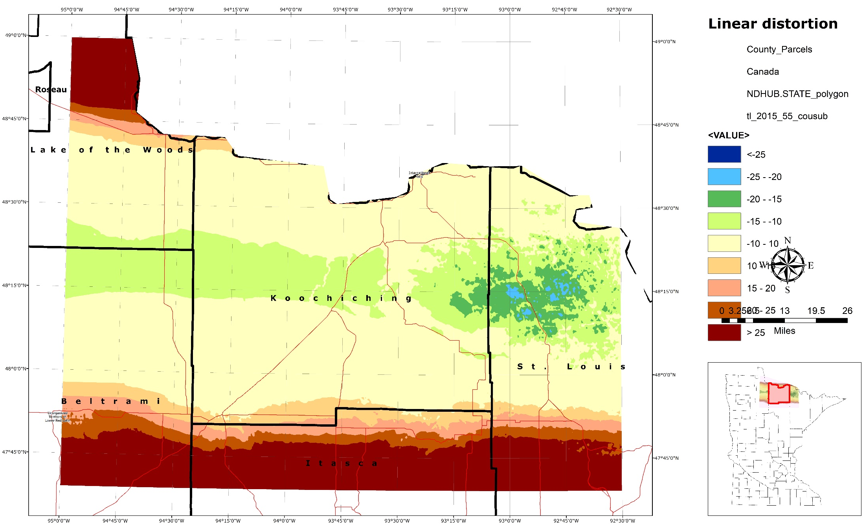
Koochiching

Slide 6
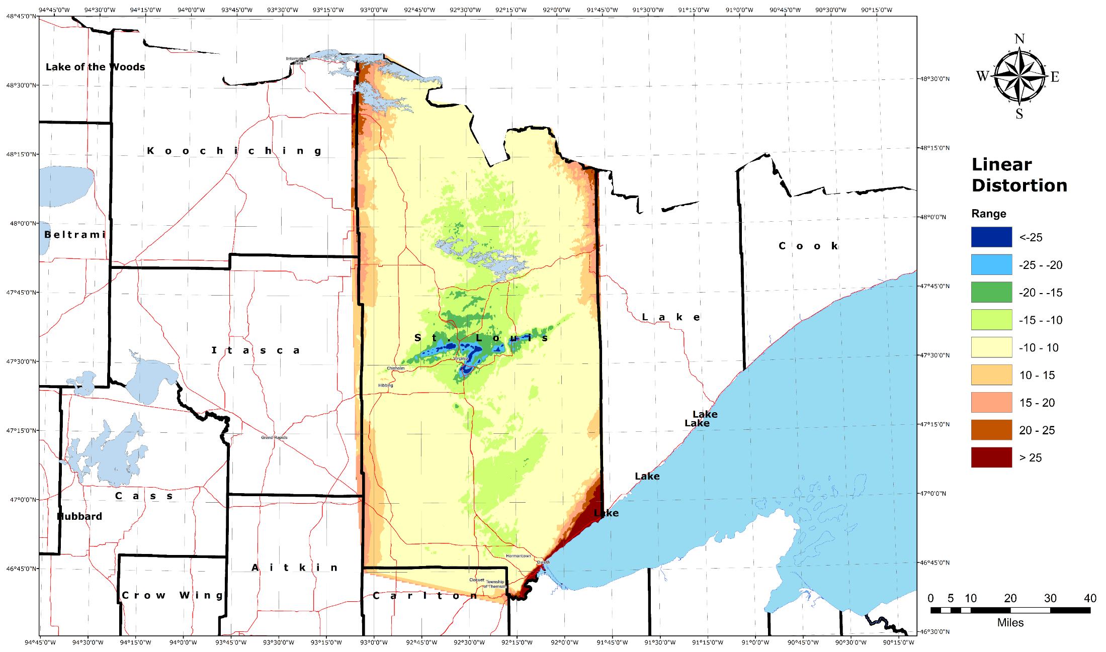
St Louis County

Slide 7
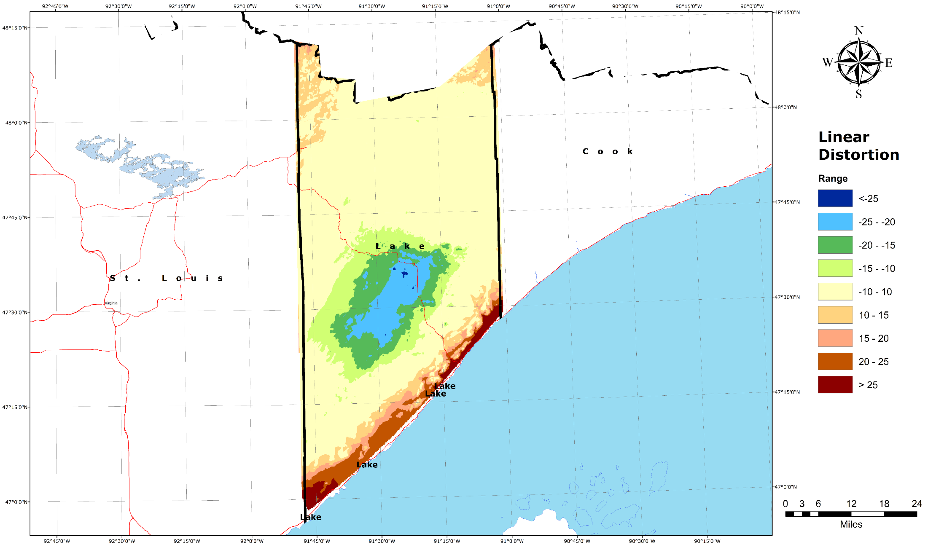
Lake

Slide 8
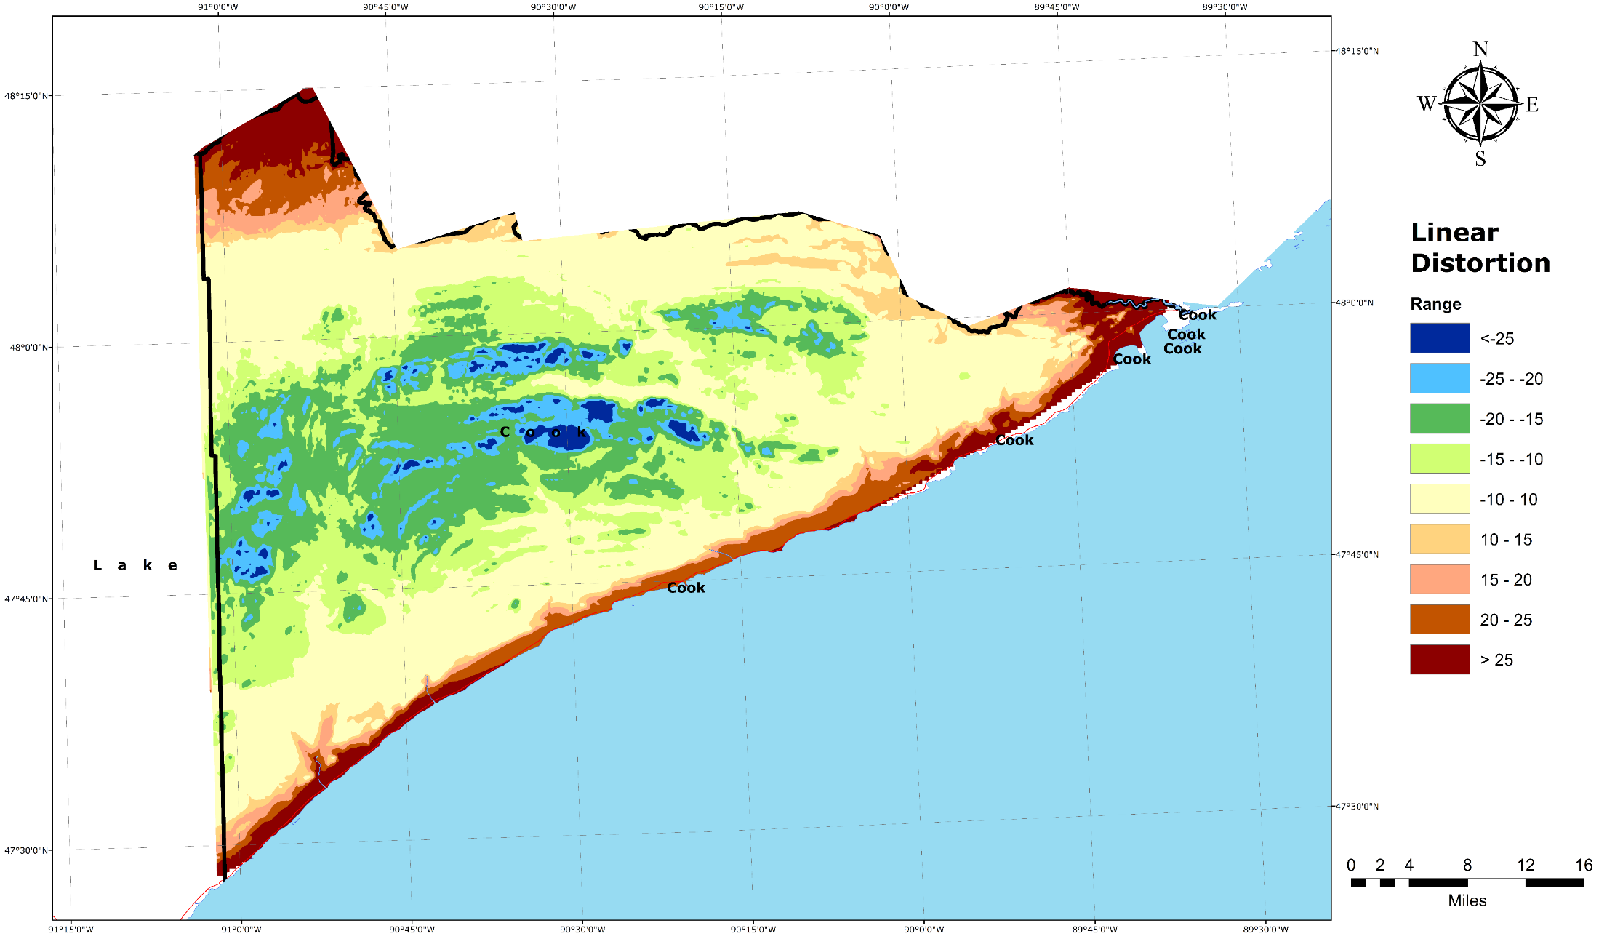
Cook

Slide 9
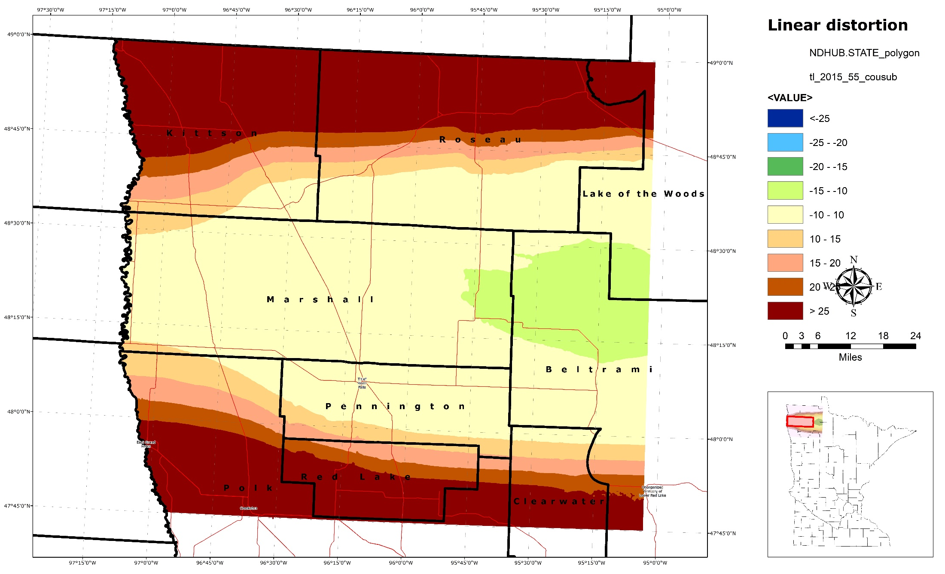
Marshall

Slide 10
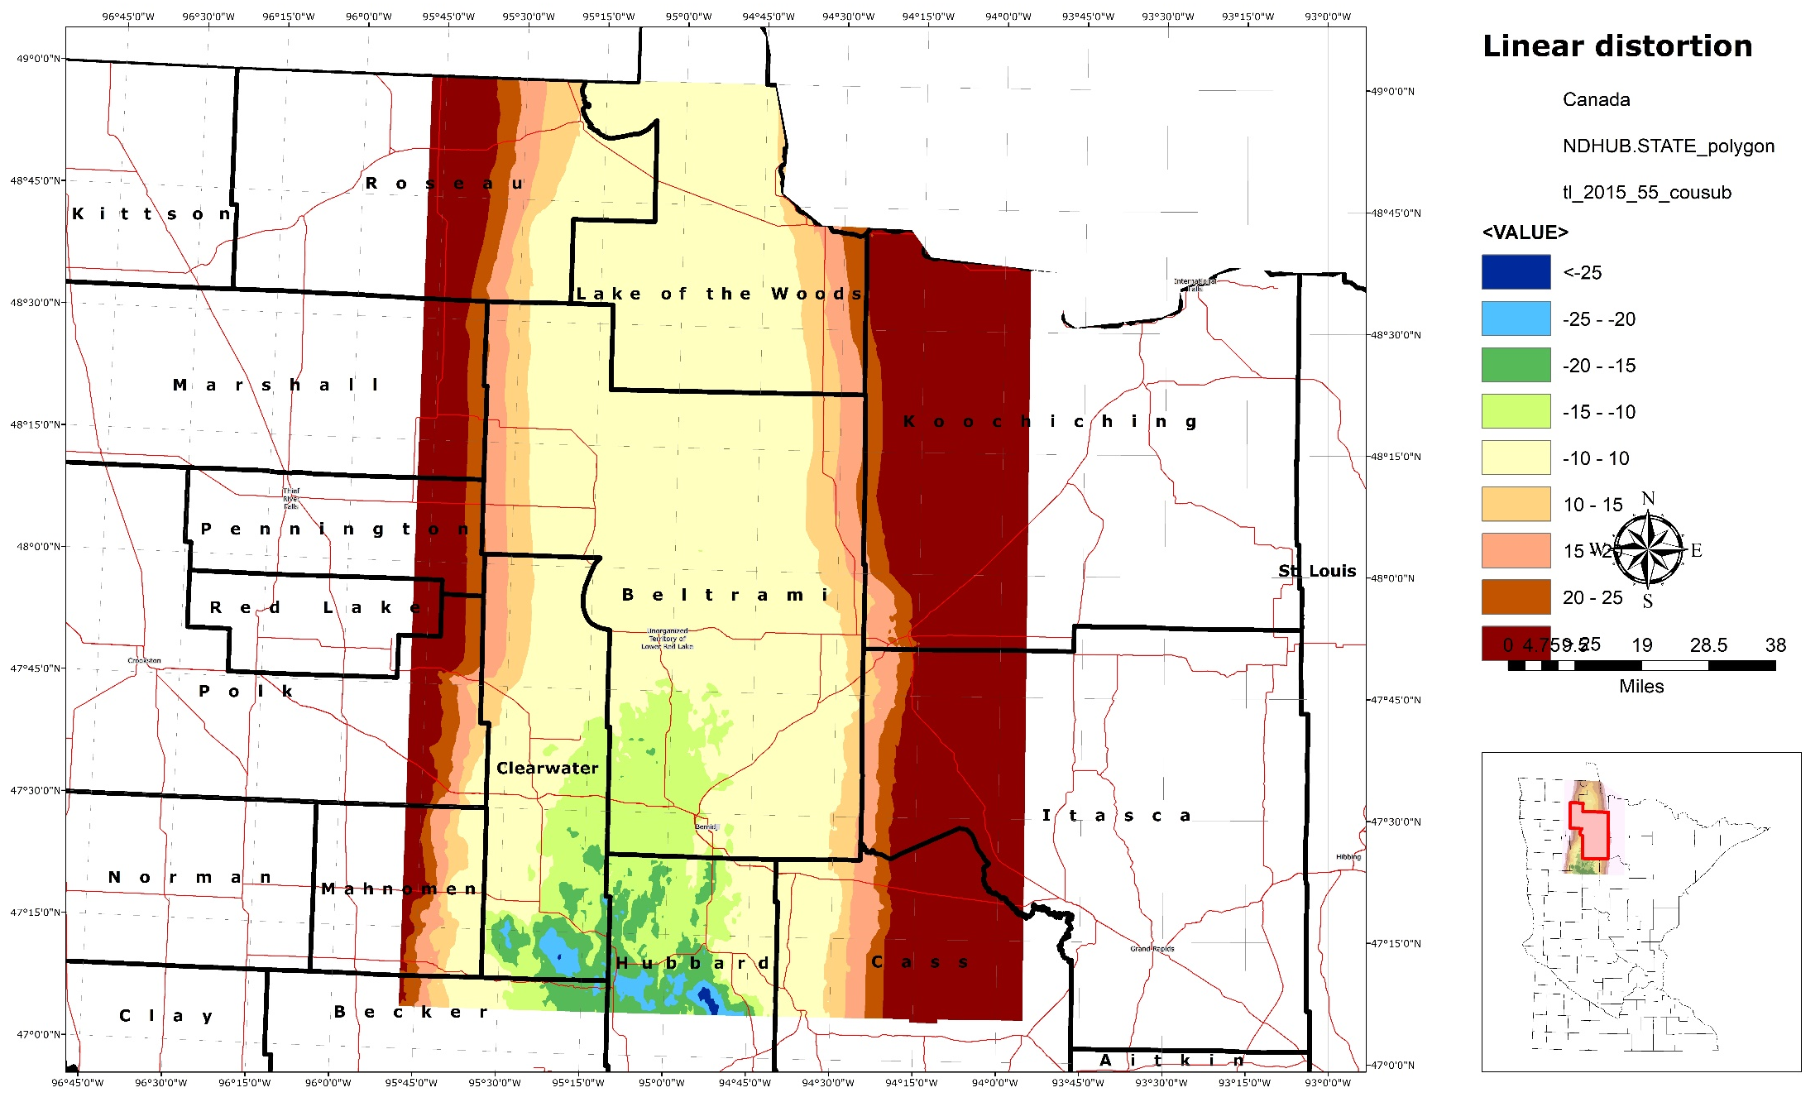
Beltrami, Clearwater

Slide 11
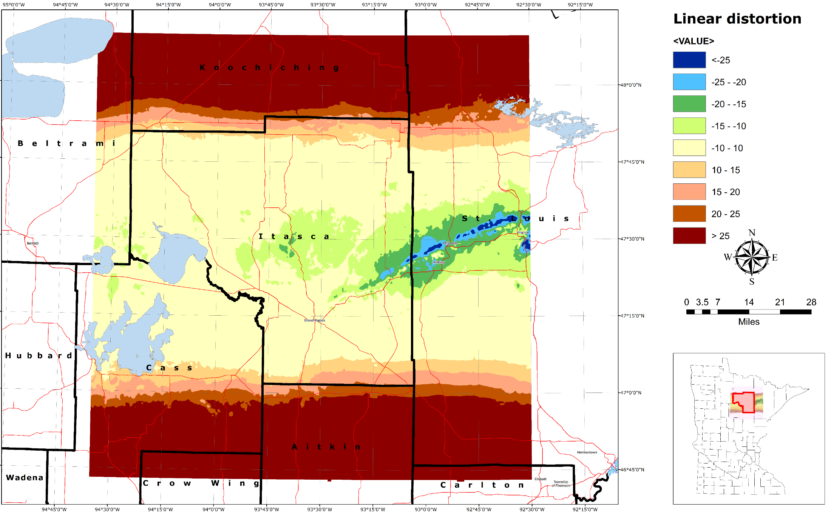
Itasca

Slide 12
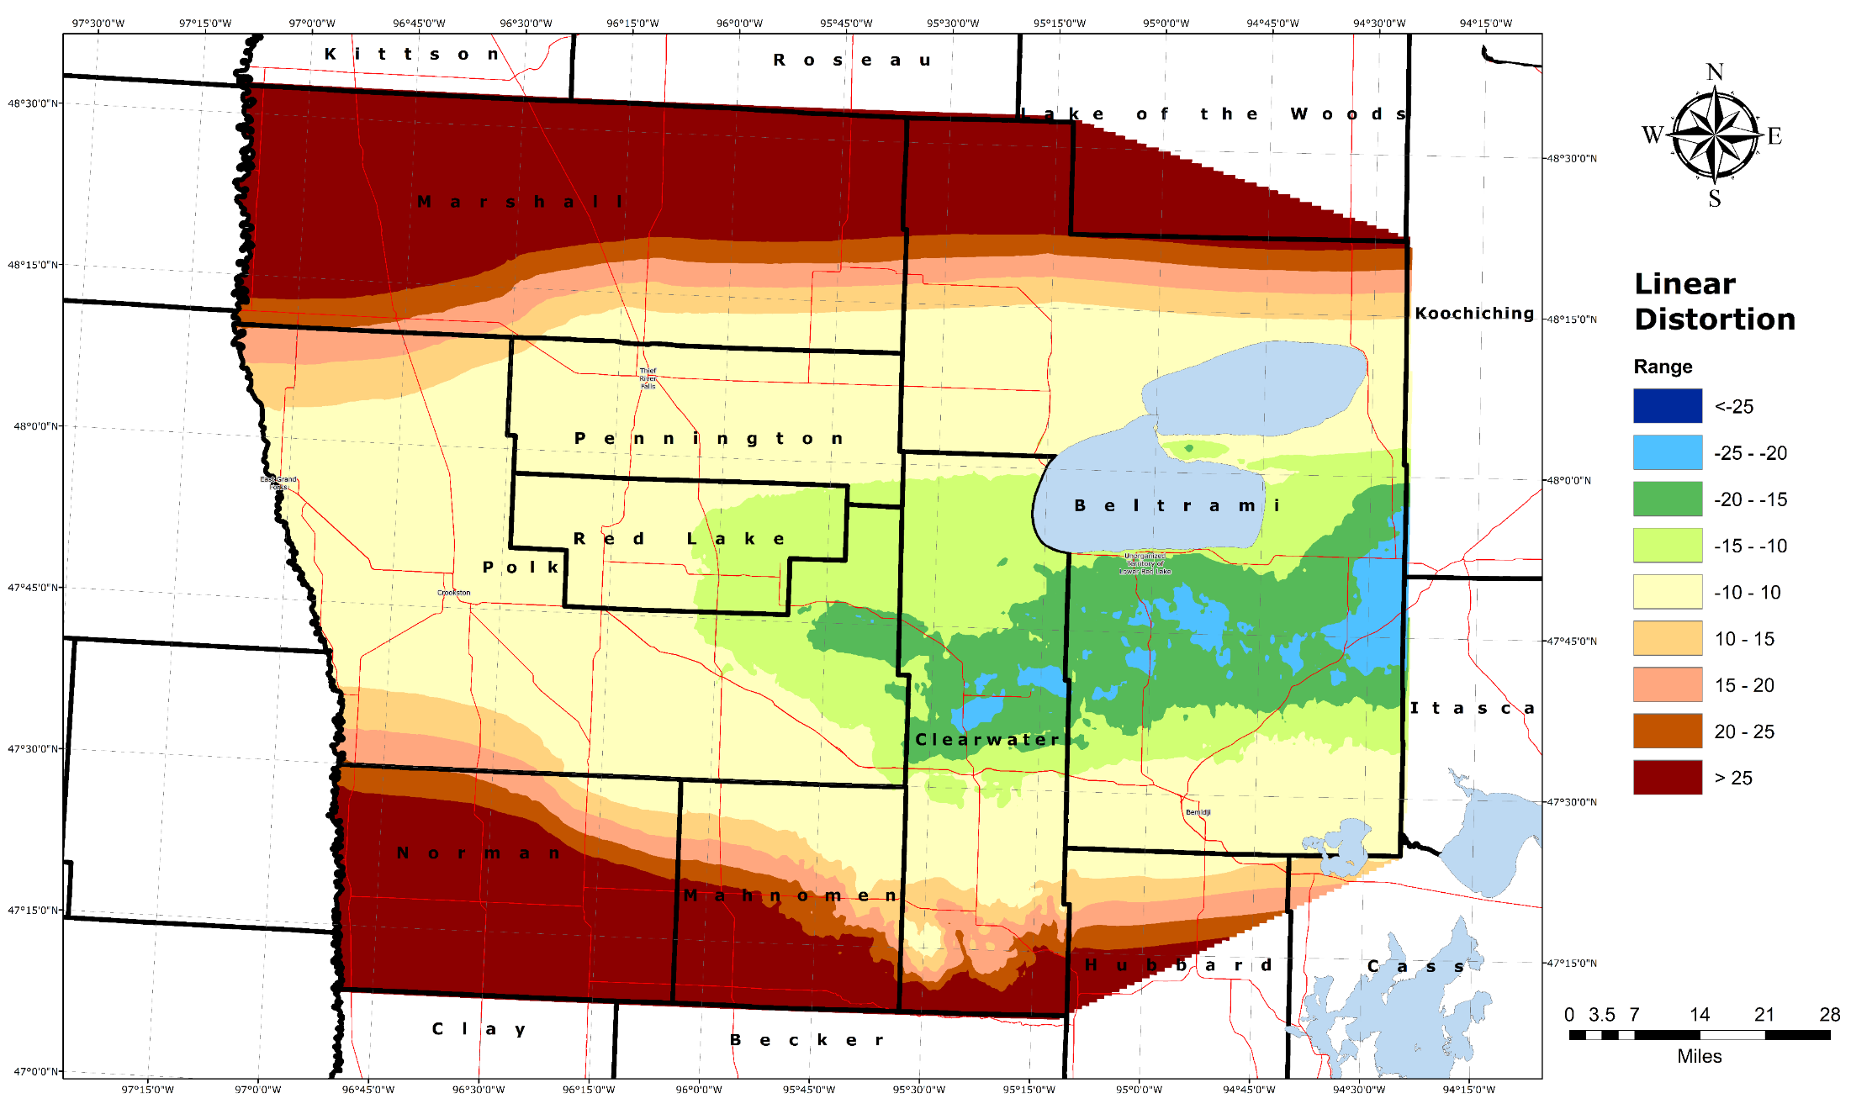
Polk, Pennington, Red Lake

Slide 13
Norman, Clay, Wilkin

Slide 14
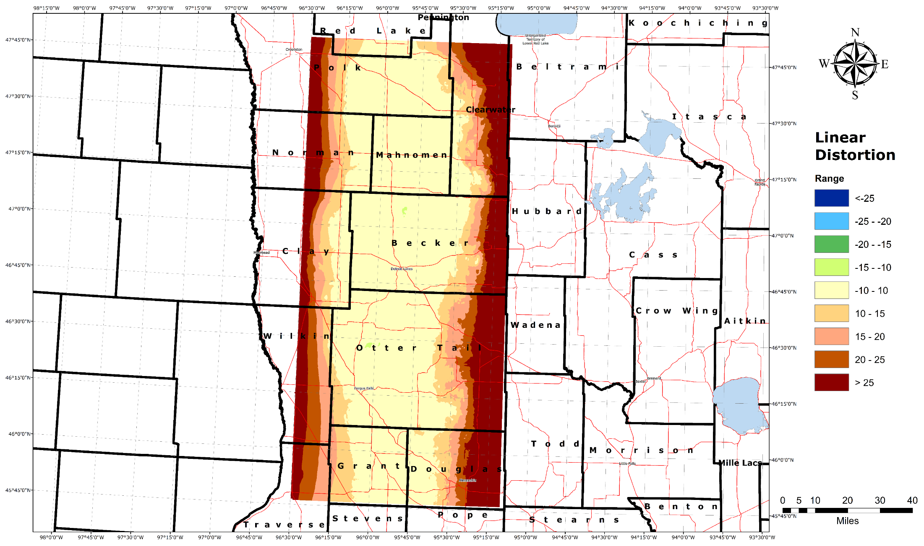
Mahnomen

Slide 15
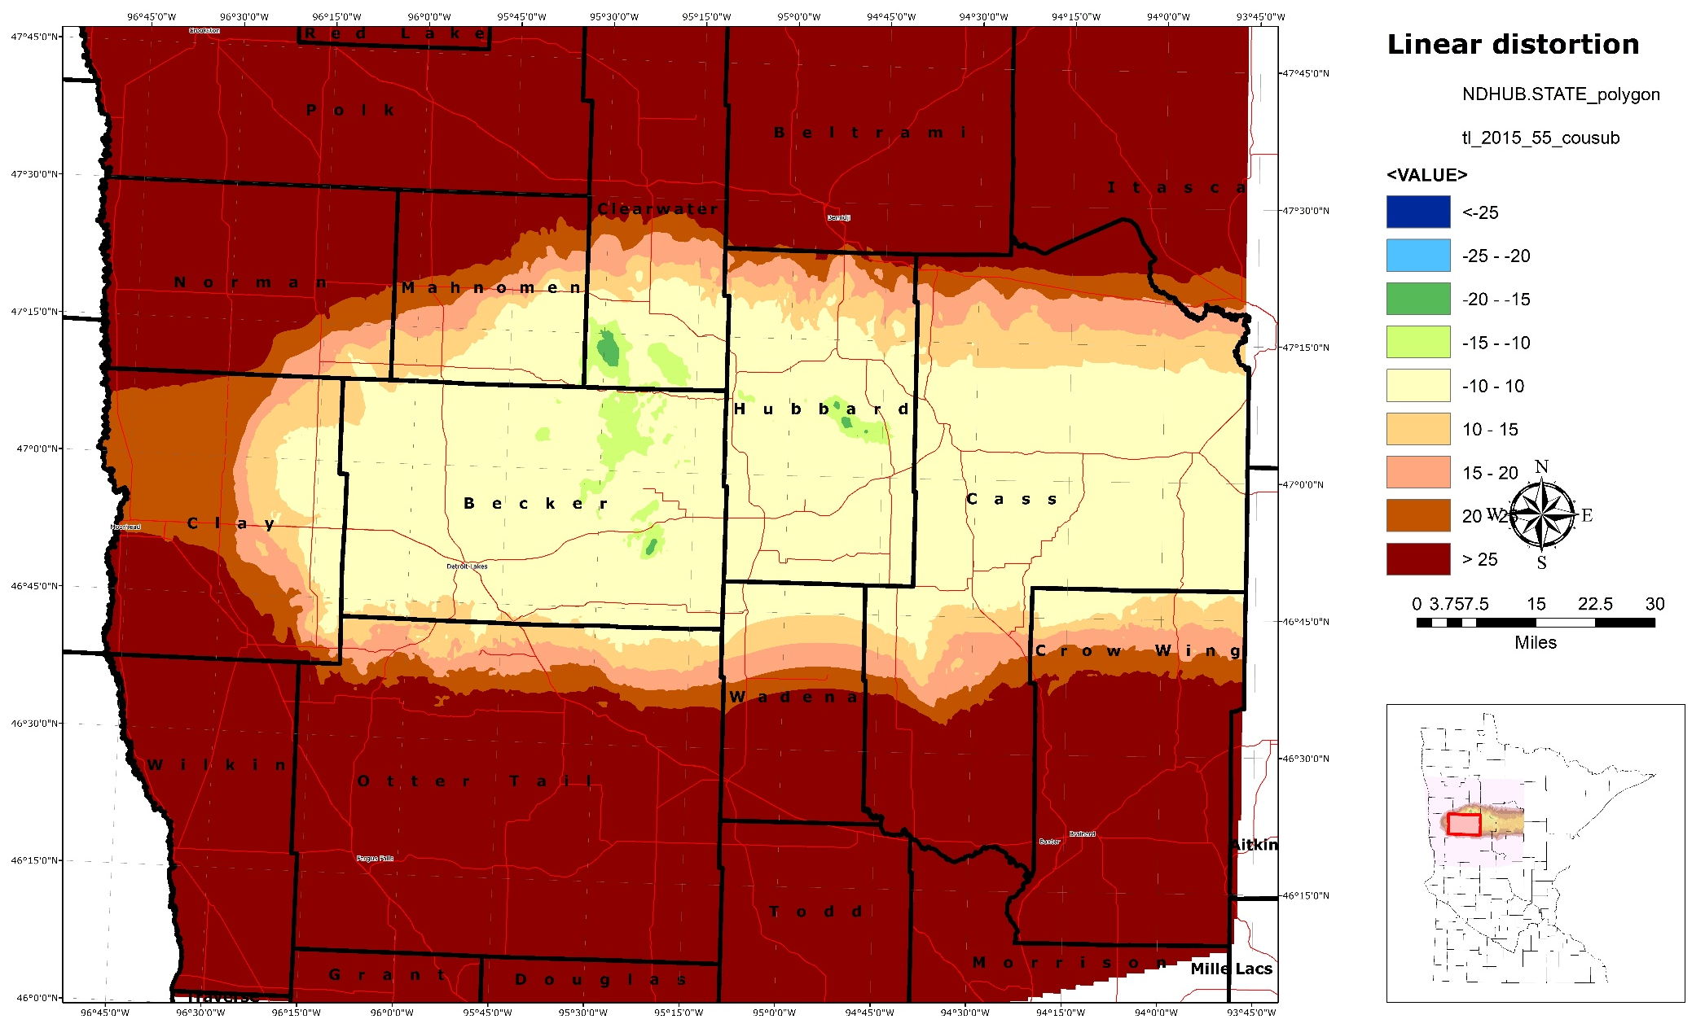
Becker

Slide 16
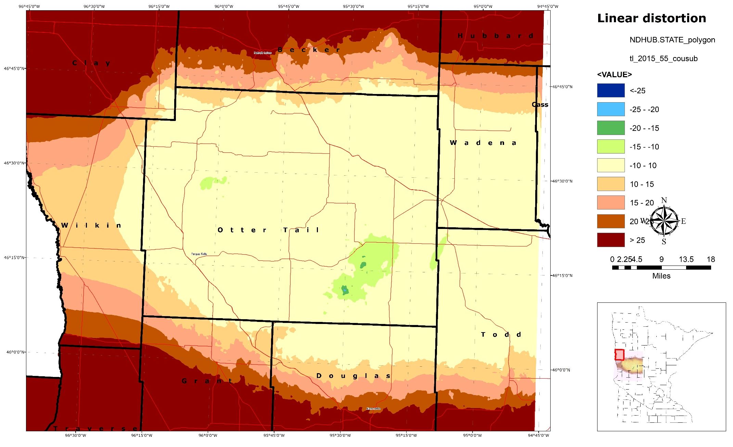
Otter Tail

Slide 17
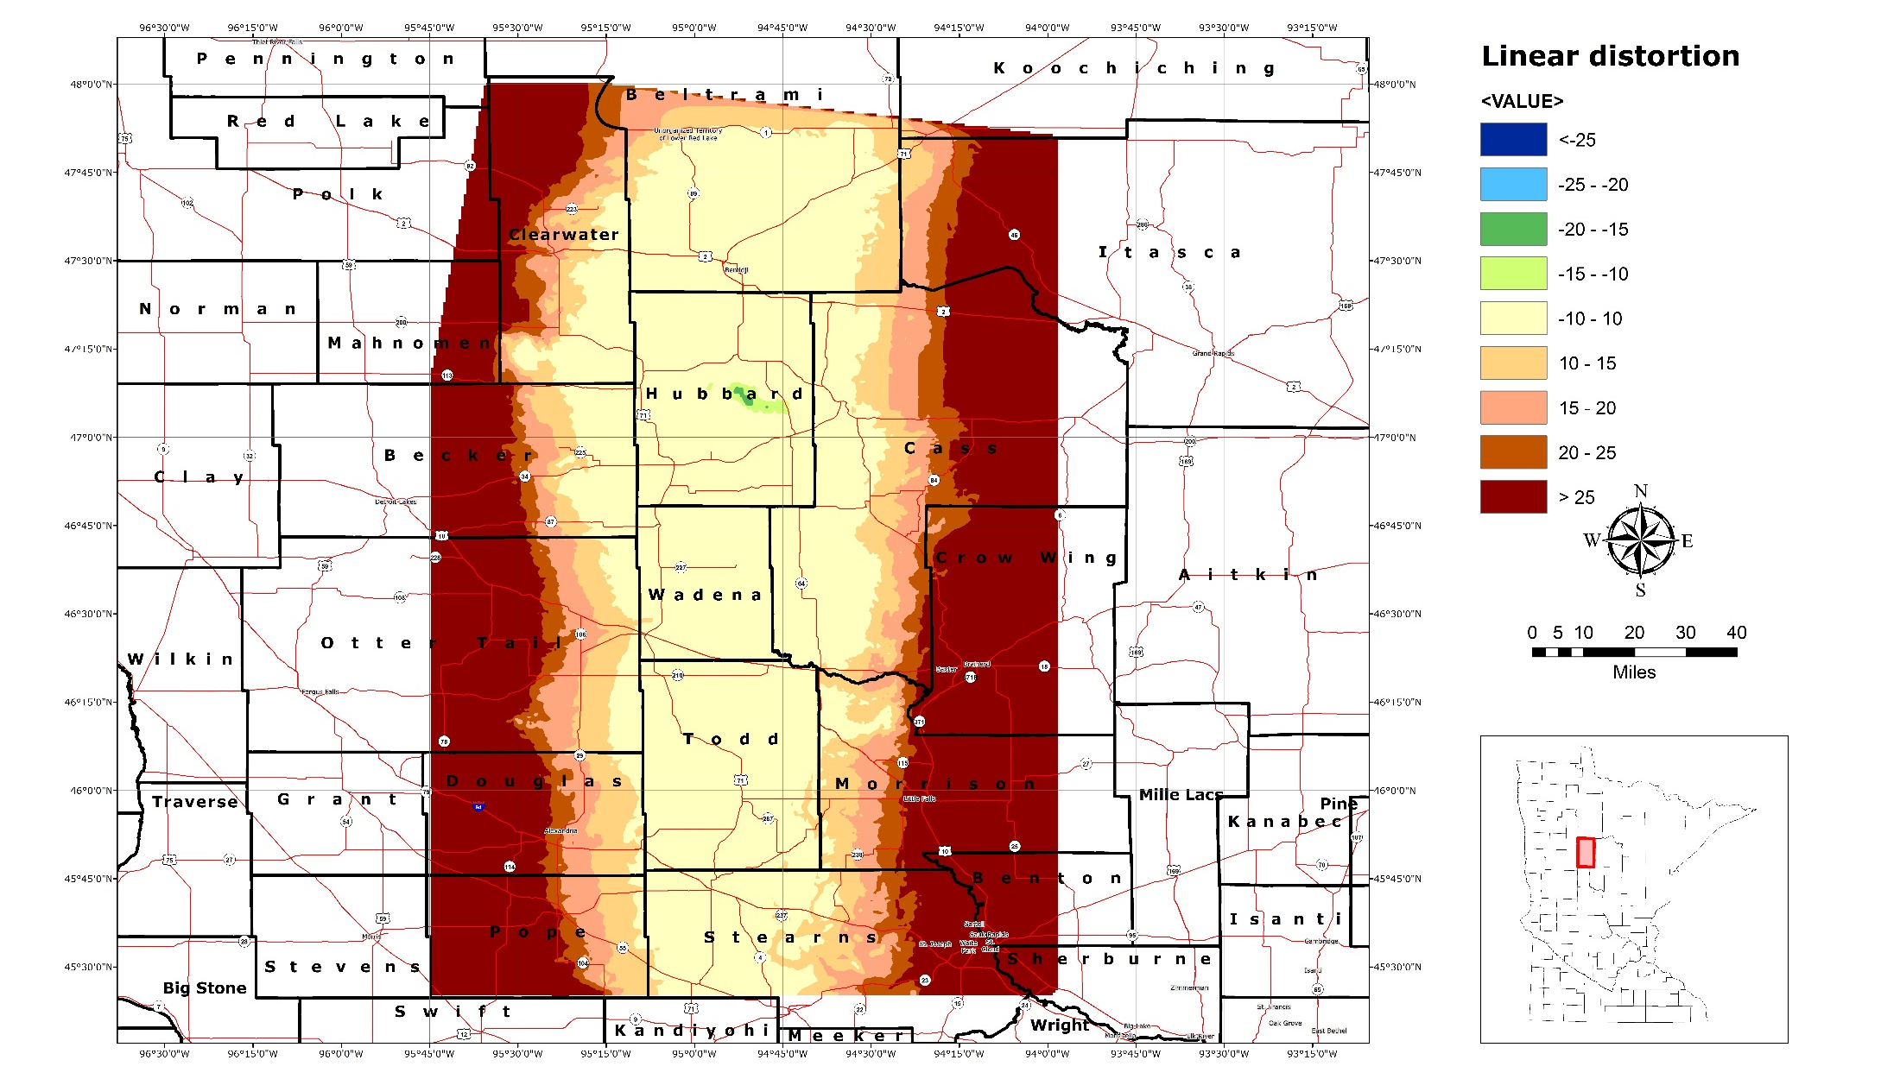
Hubbard, Wadena, Todd

Slide 18
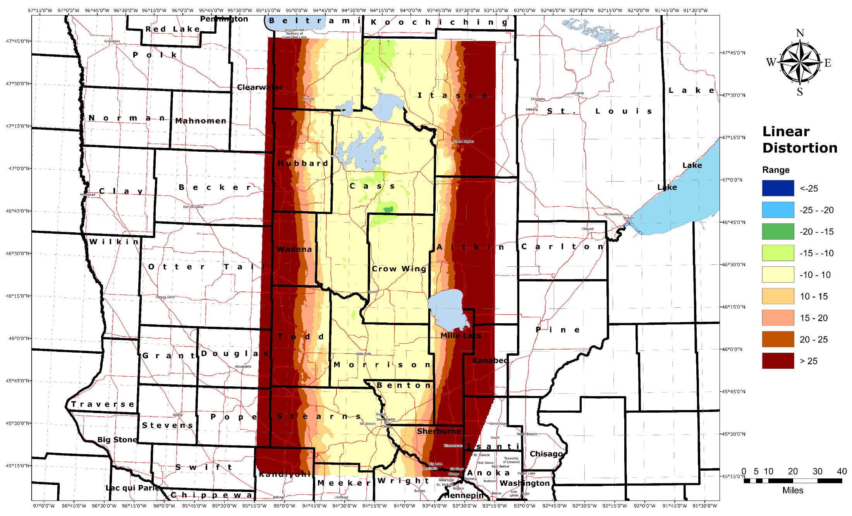
Cass, Crow Wing, Morrison

Slide 19
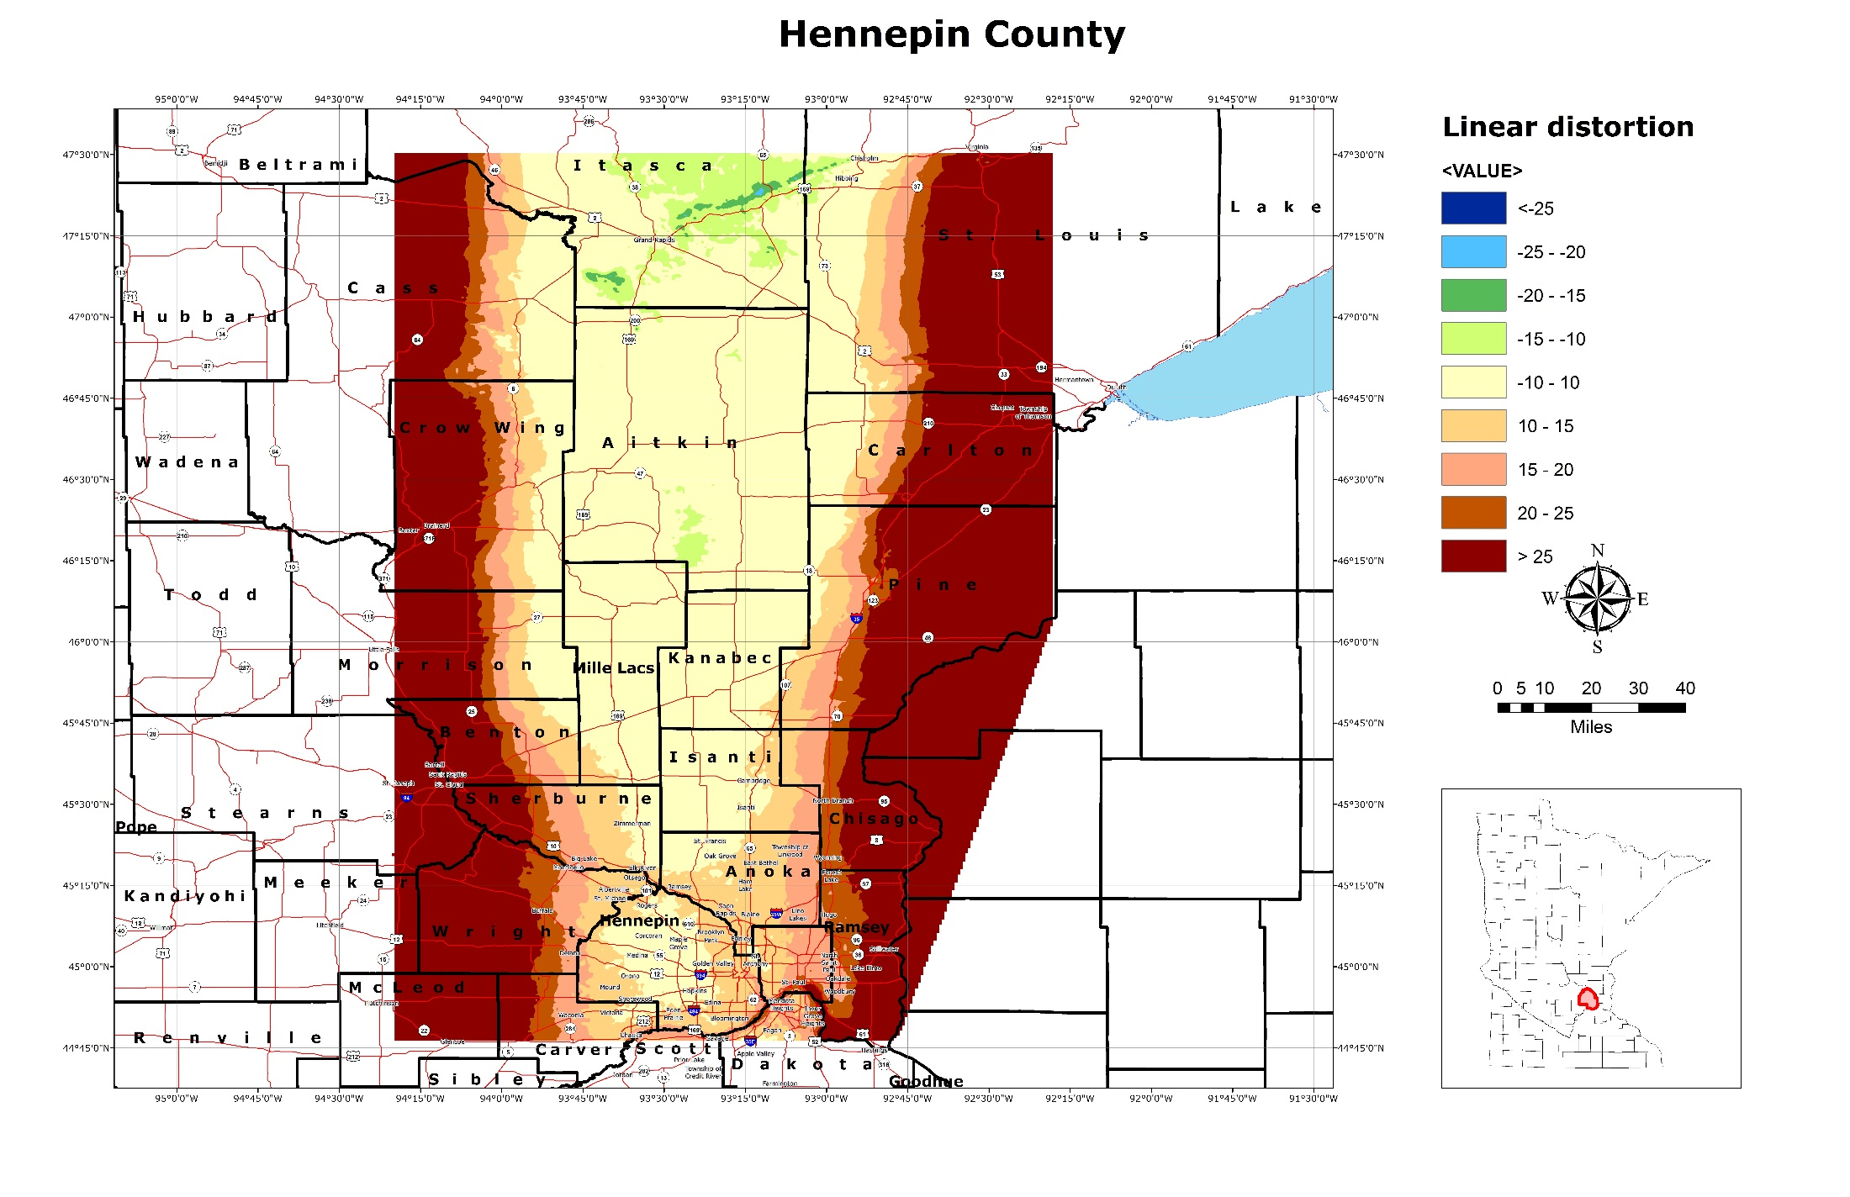
Aitkin, Mille Lacs, Kanabec

Slide 20
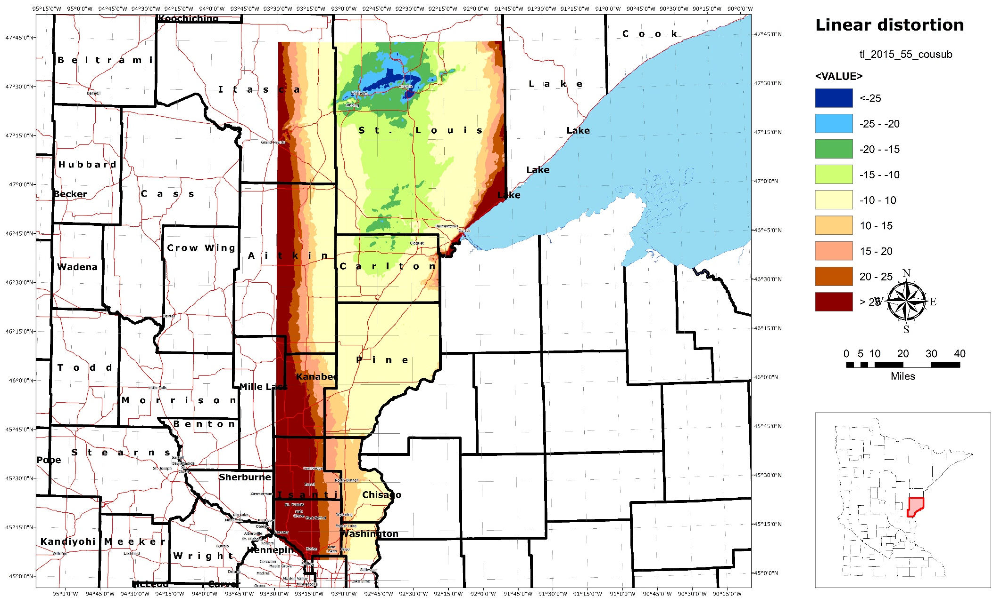
Carlton, Pine

Slide 21
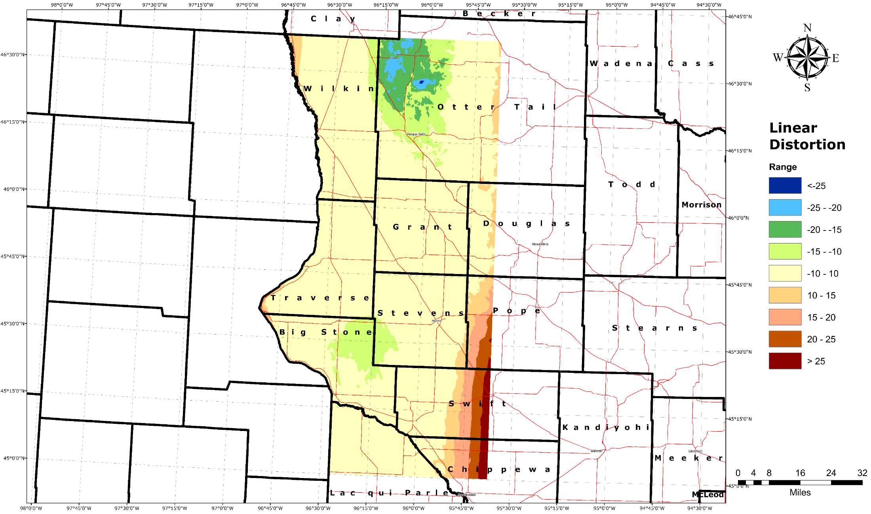
Traverse, Big Stone, Grant, Stevens

Slide 22
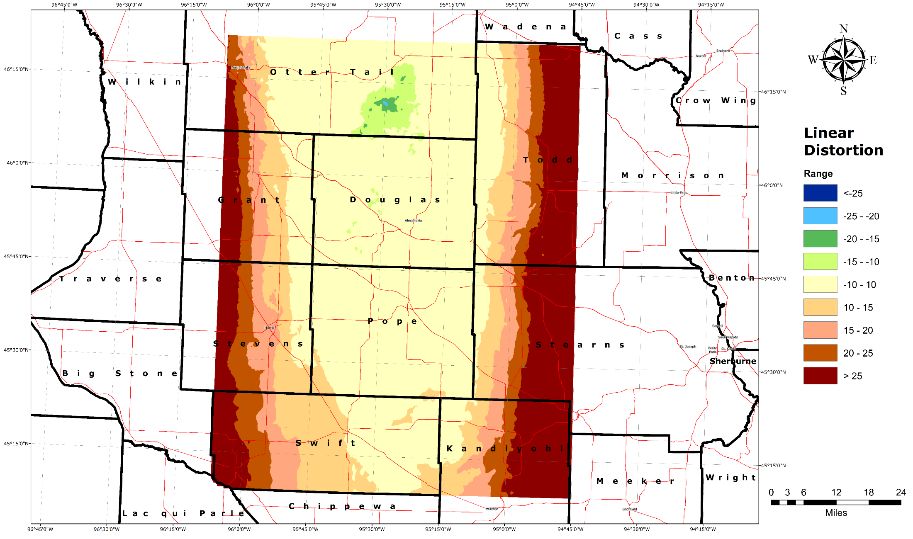
Douglas, Pope

Slide 23
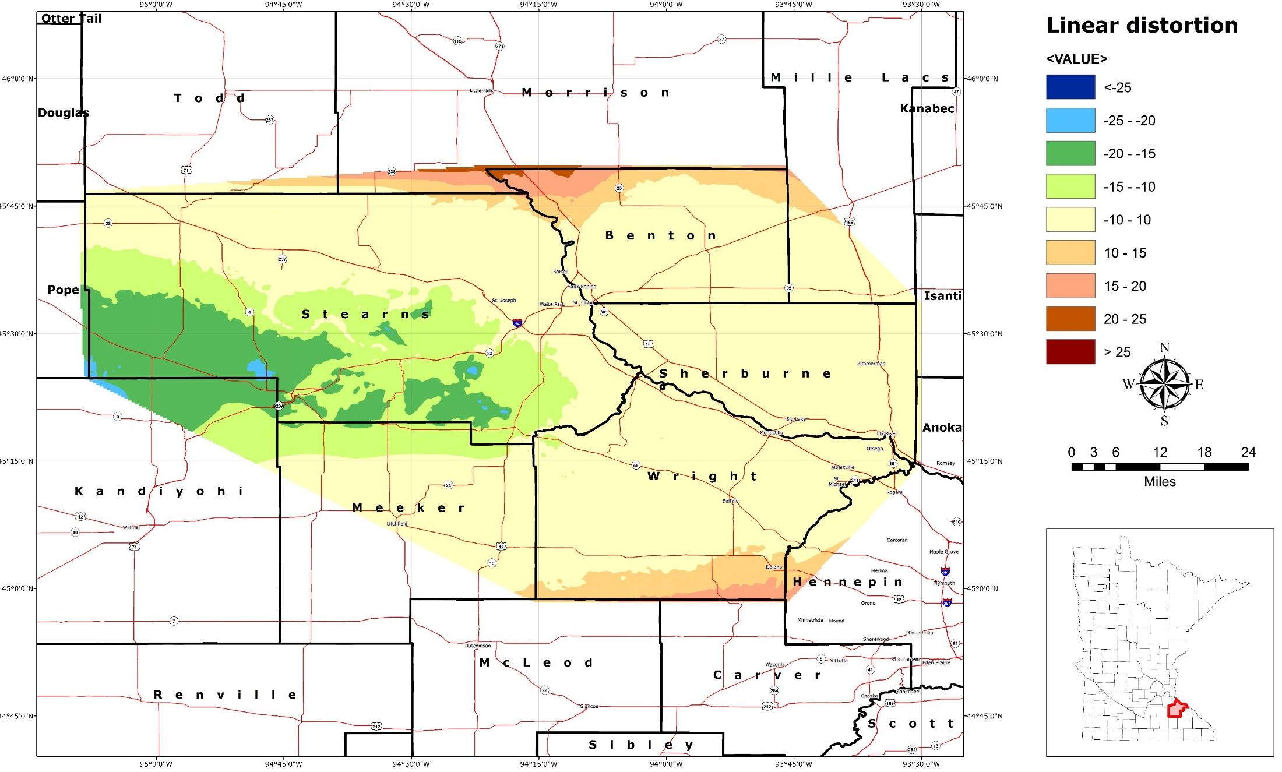
Stearns, Benton, Sherburne, Wright

Slide 24
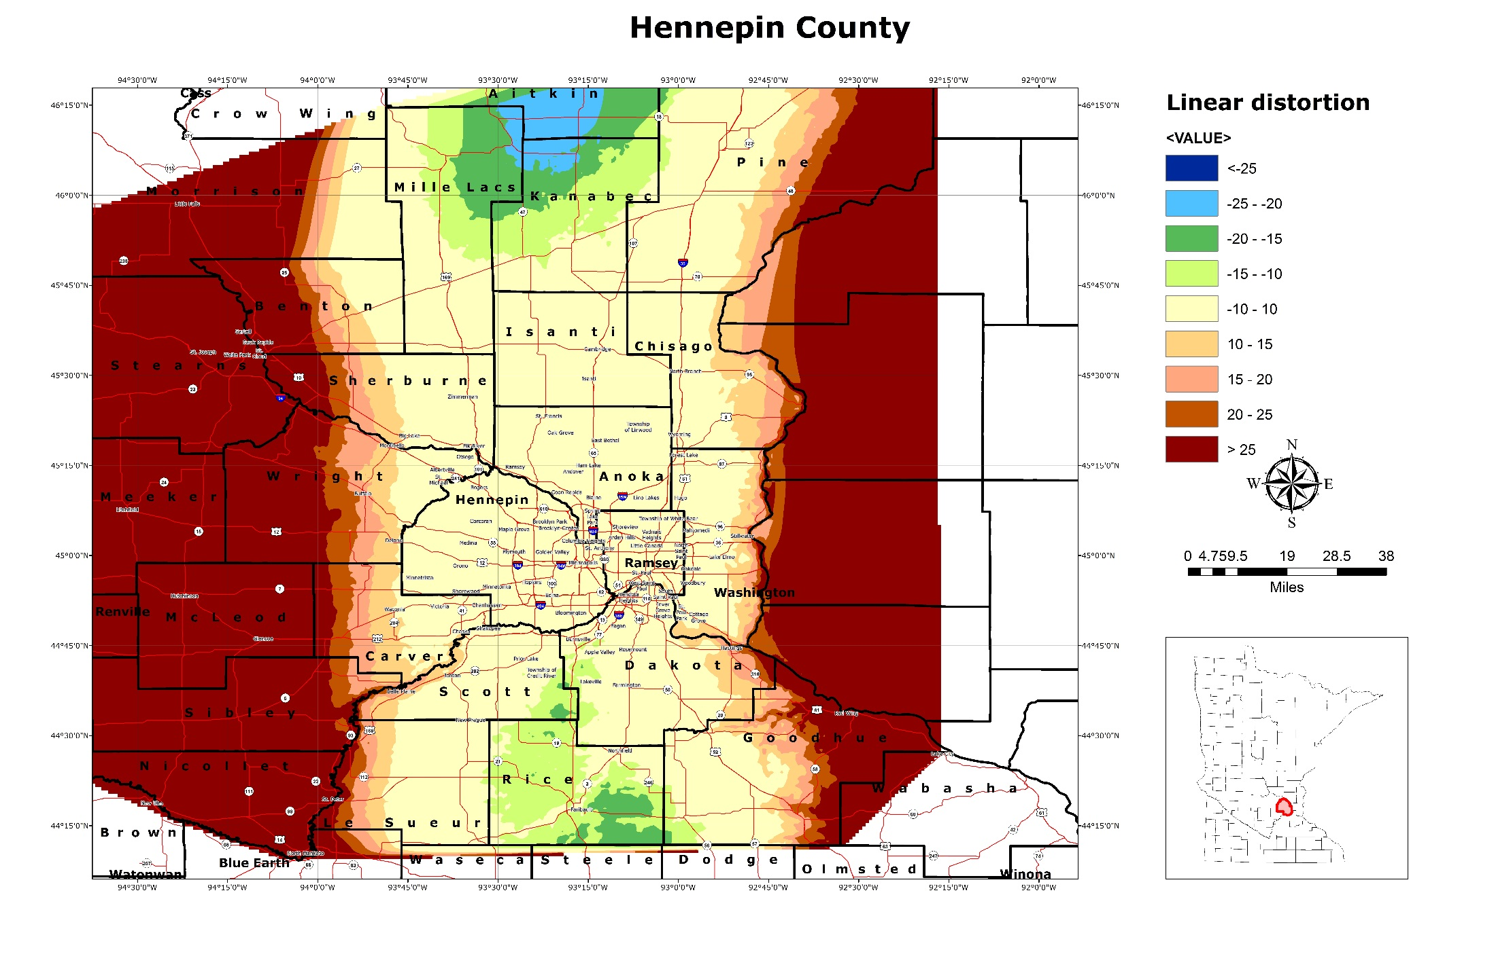
Hennepin, Ramsey, Anoka, Isanti

Slide 25
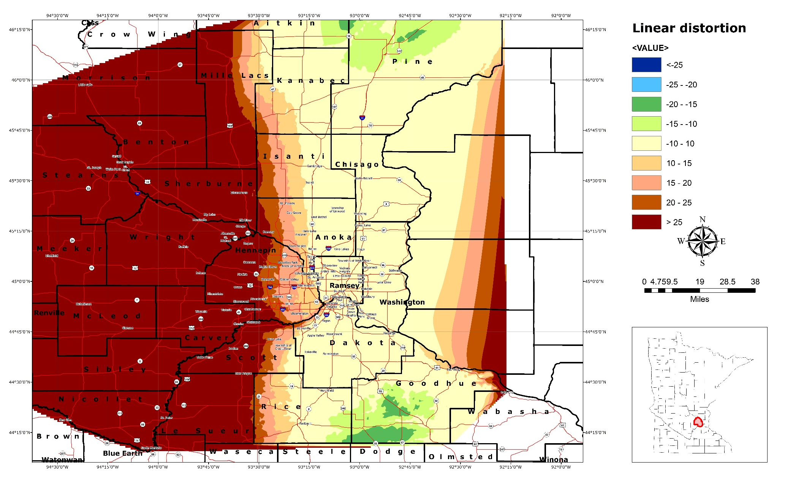
Chisago, Washington

Slide 26
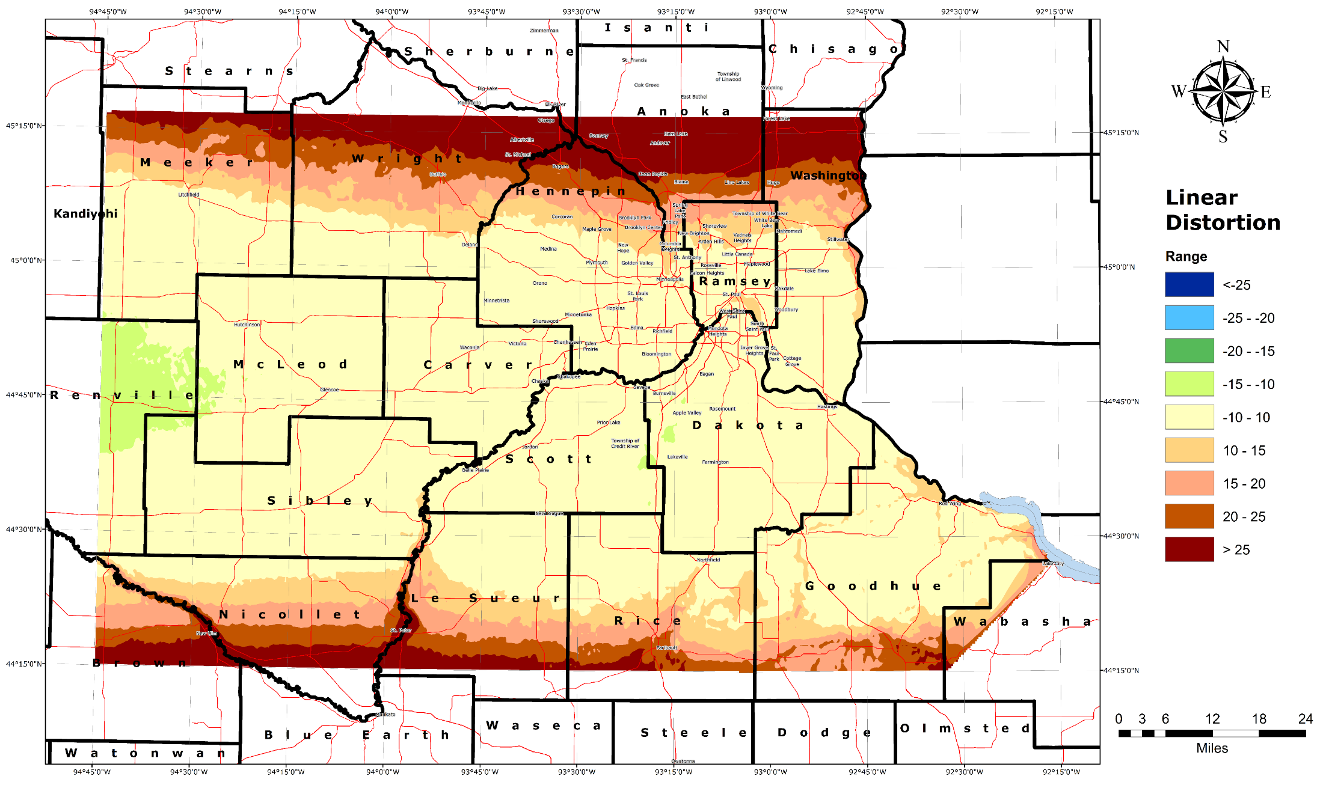
Carver, Scott, Dakota

Slide 27
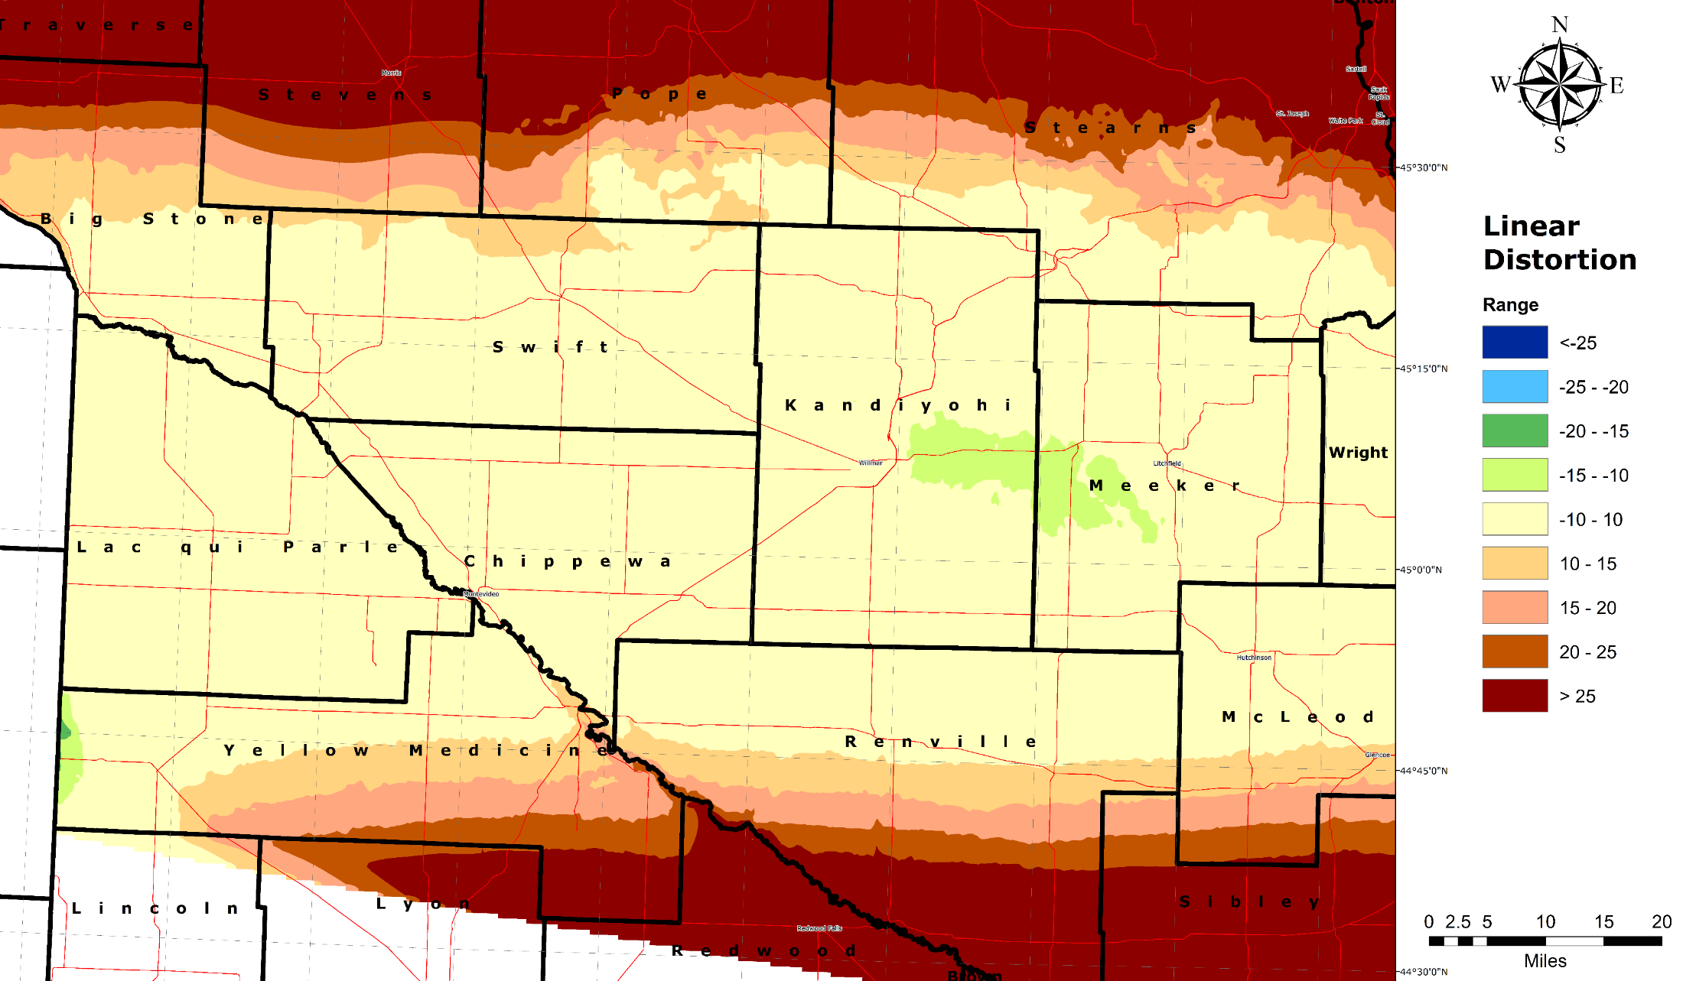
Lac Qui Parle, Swift, Chippewa, Kandiyohi, Meeker

Slide 28
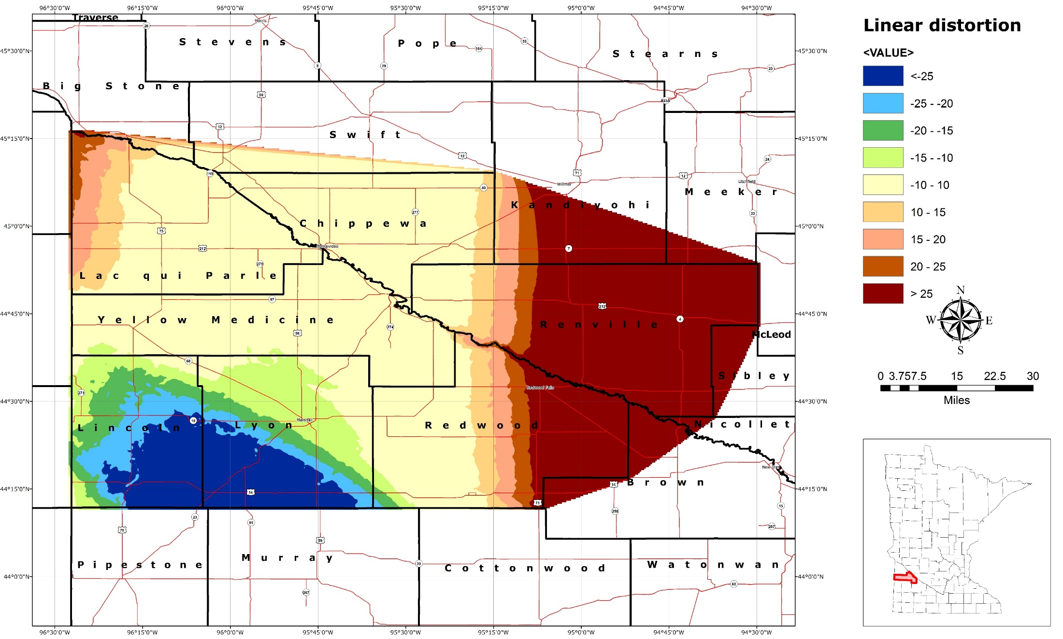
Yellow Medicine

Slide 29
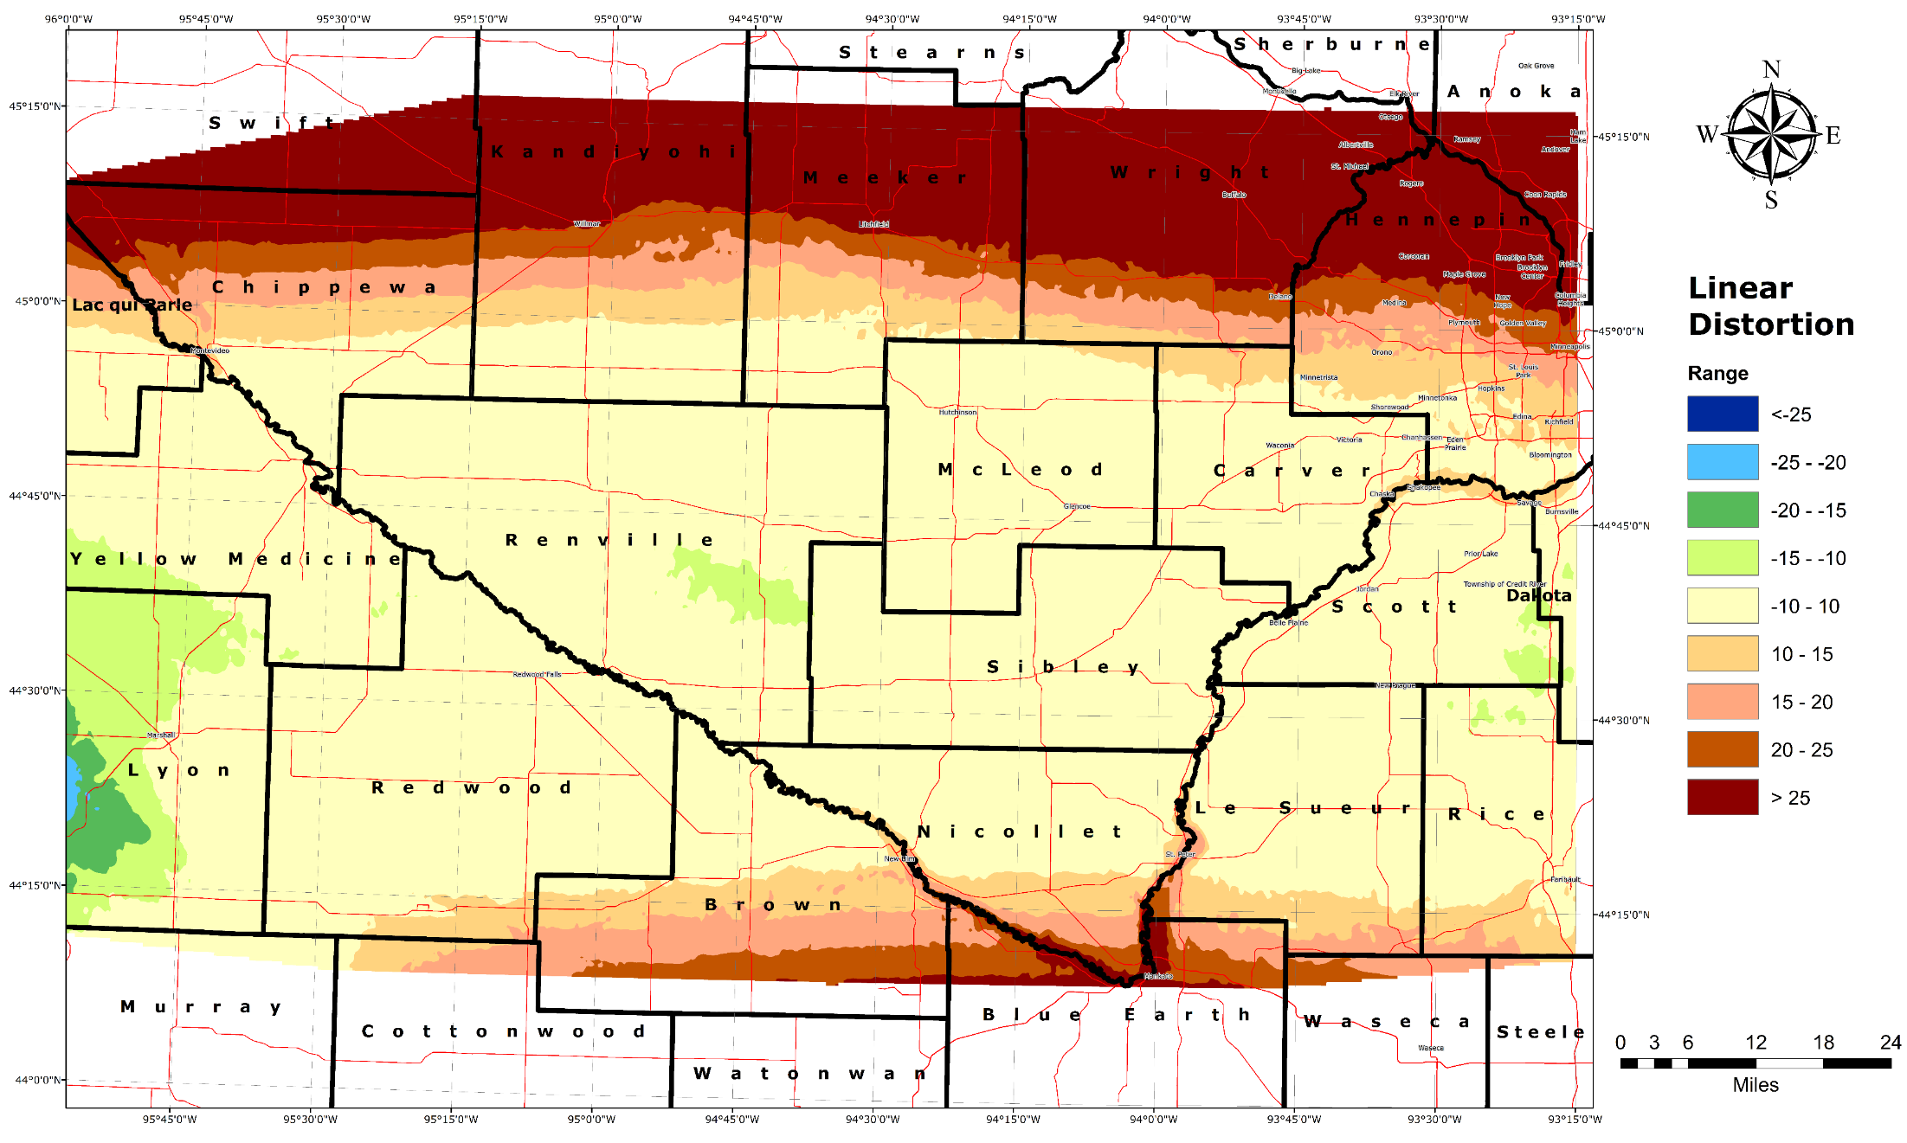
Redwood, Renville, Mcleod, Sibley

Slide 30
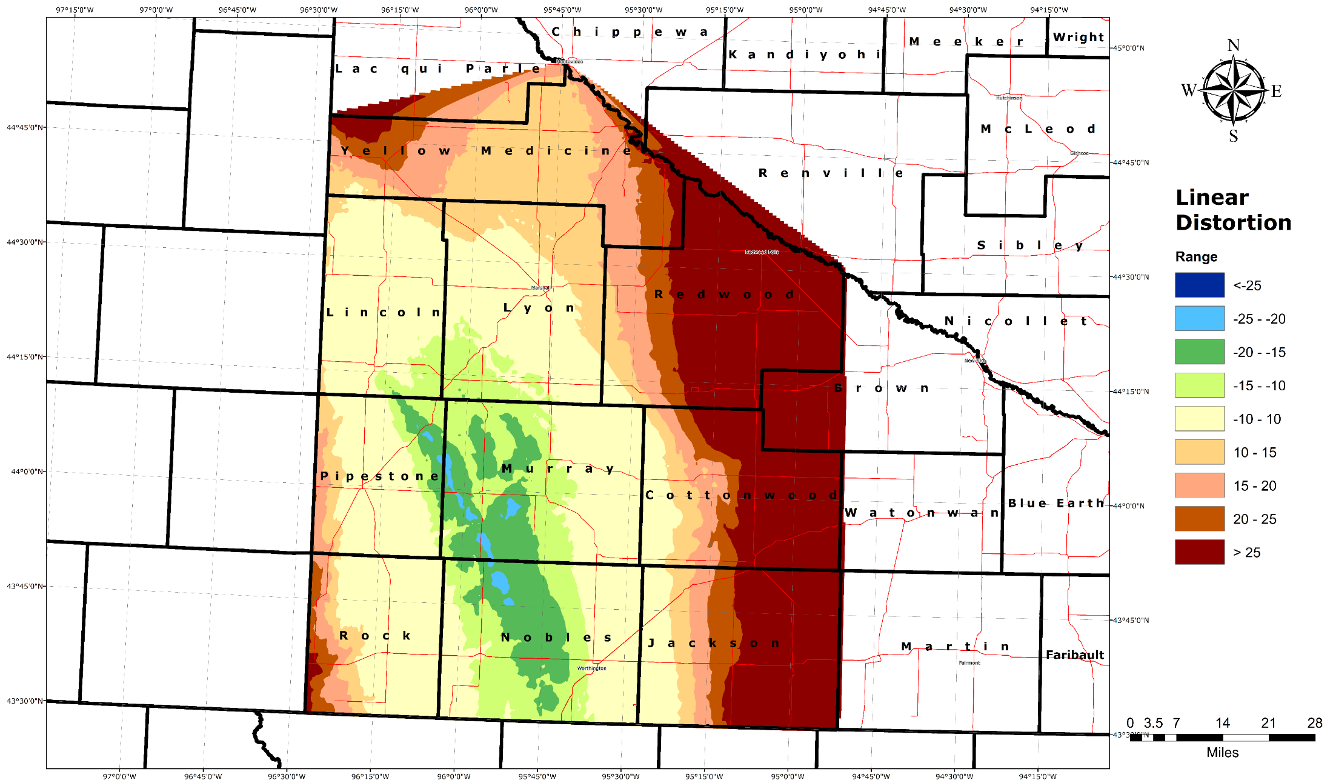
Lincoln, Lyon, Pipestone, Murray

Slide 31
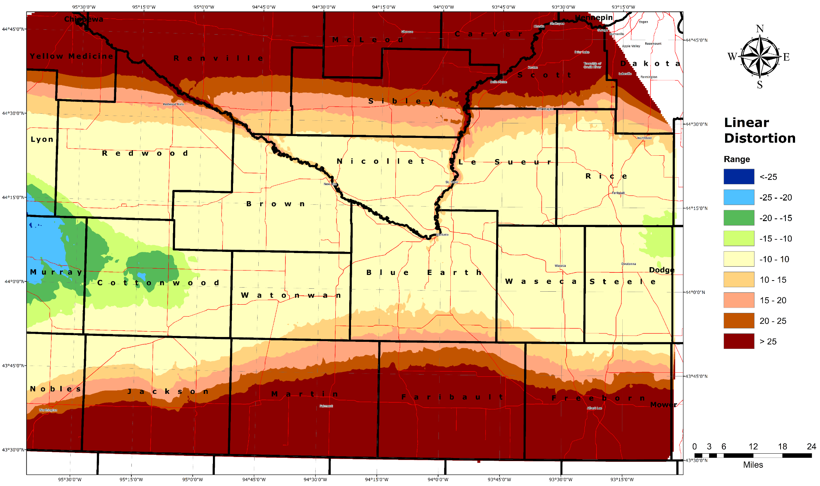
Cottonwood, Brown, Watonwan, Nicollet, Blue Earth, Le Sueur, Waseca

Slide 32
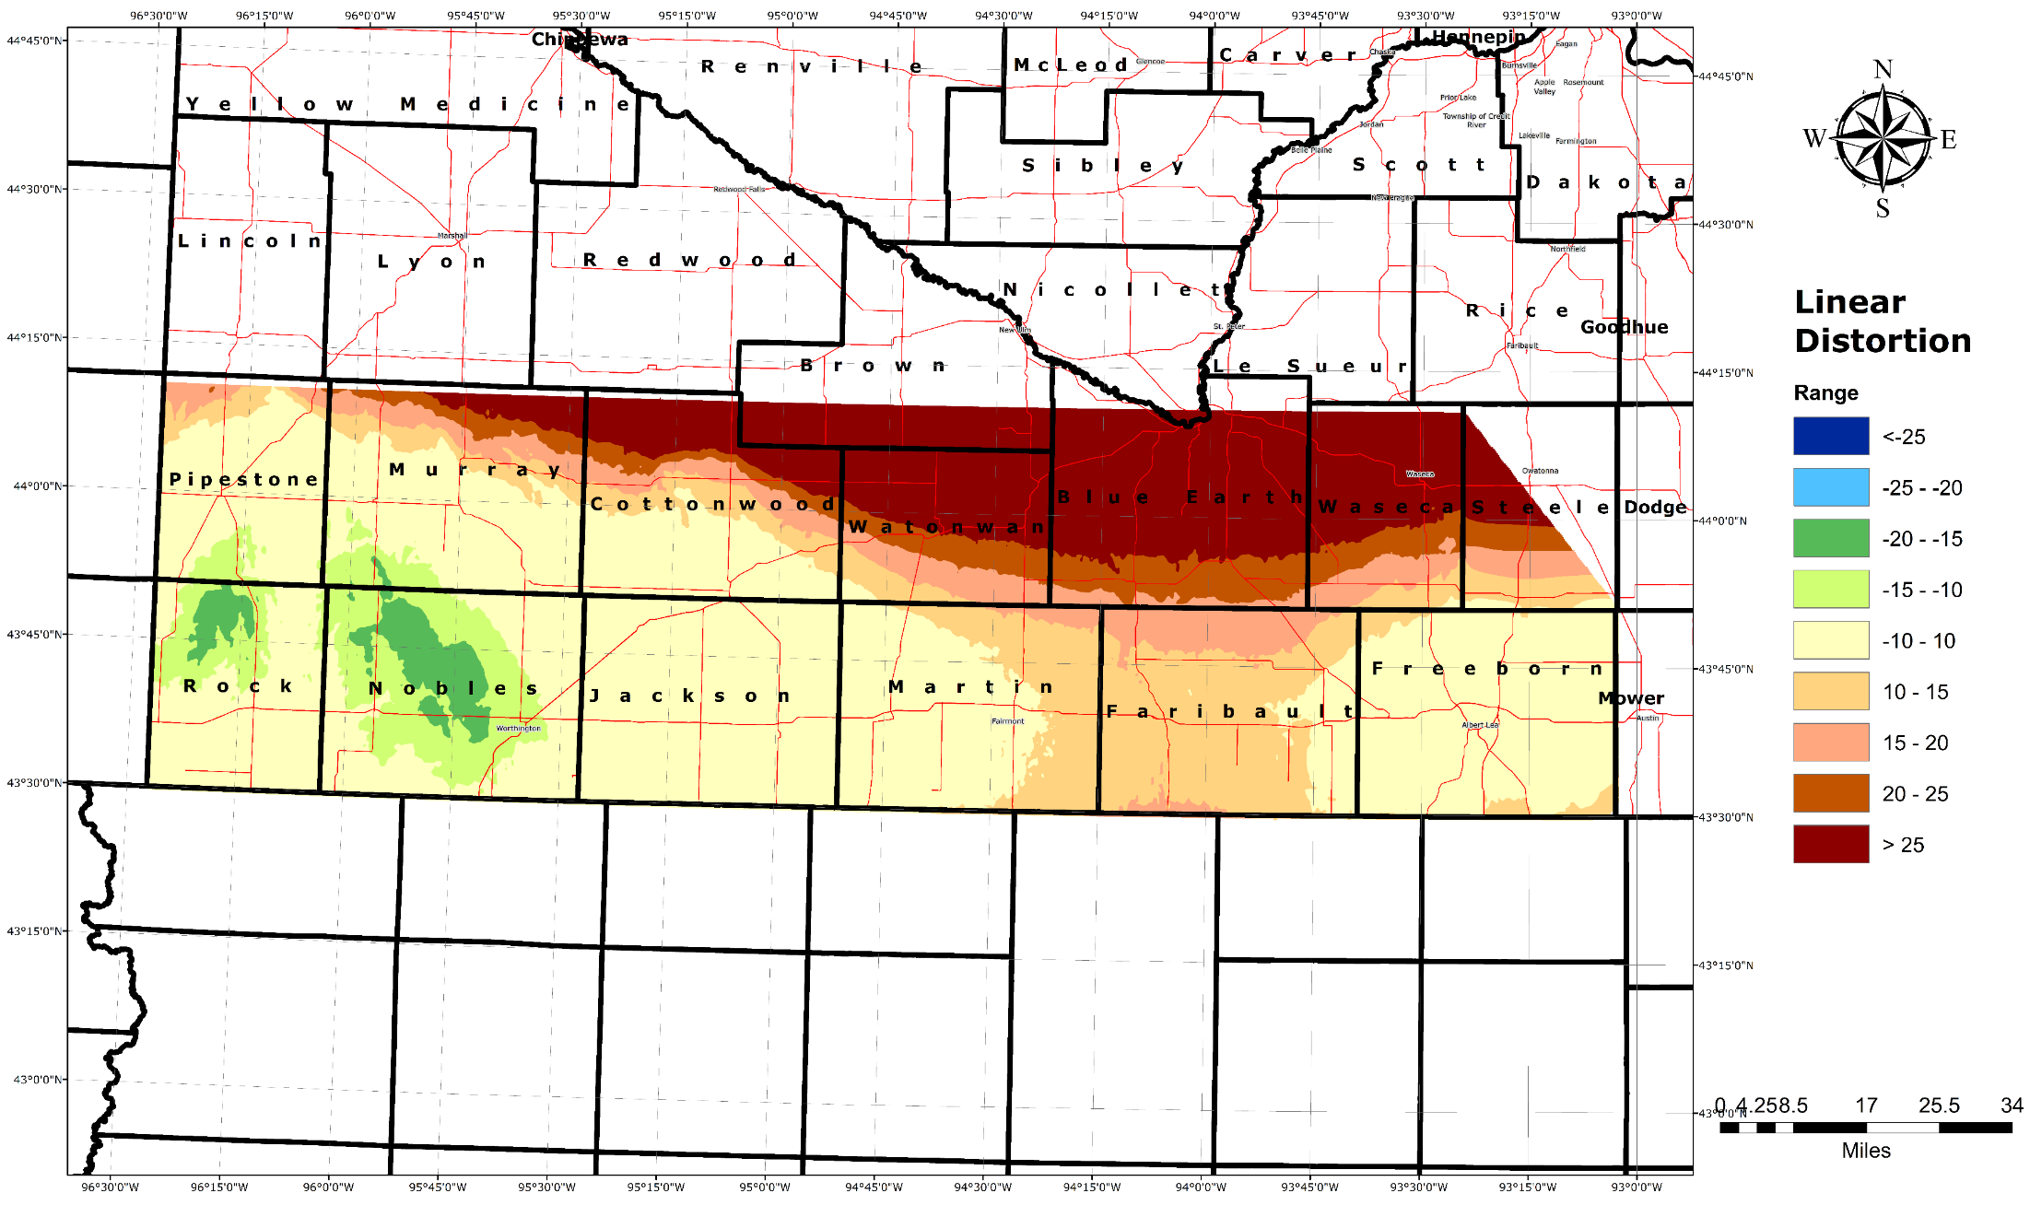
Rock, Nobles, Jackson, Martin, Faribault, Freeborn

Slide 33
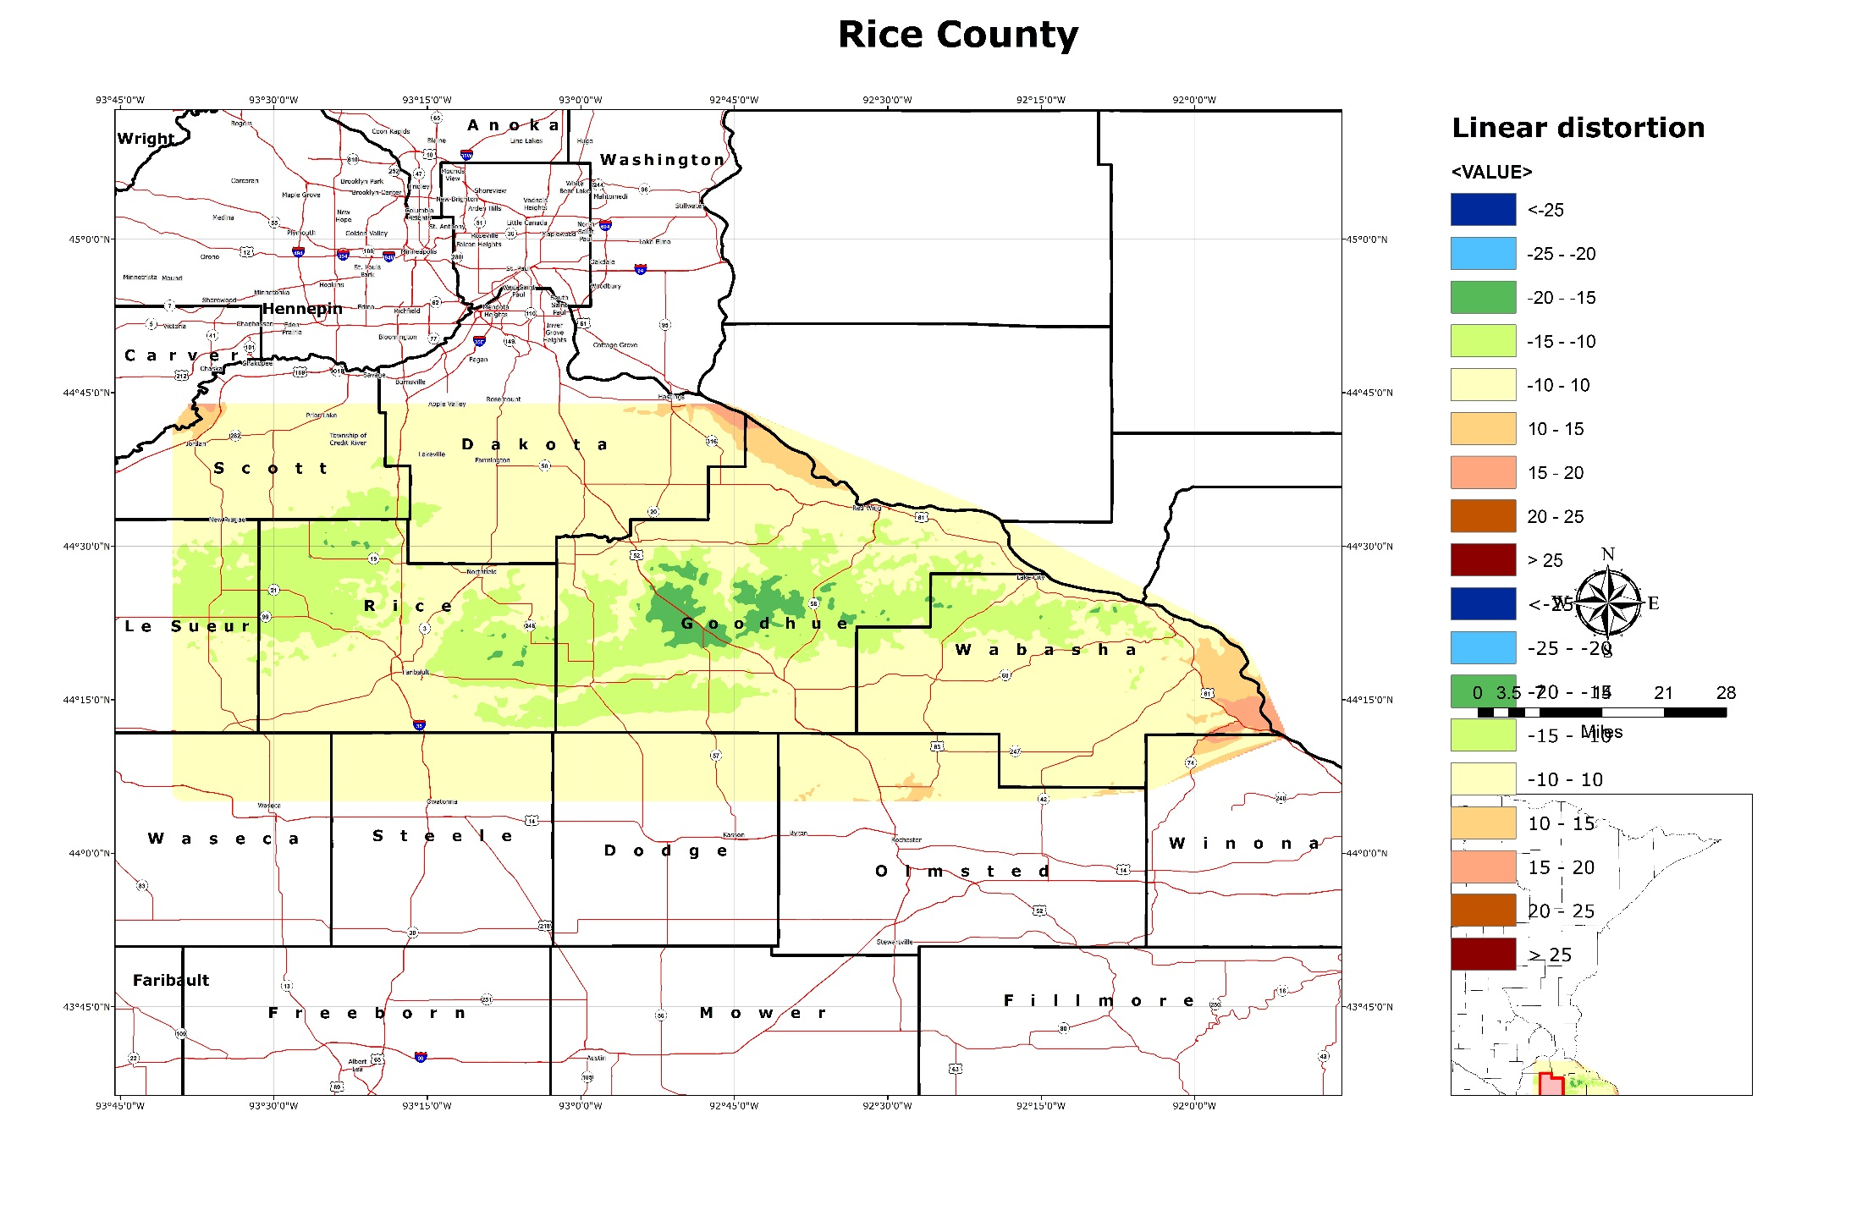
Rice, Goodhue, Wabasha

Slide 34
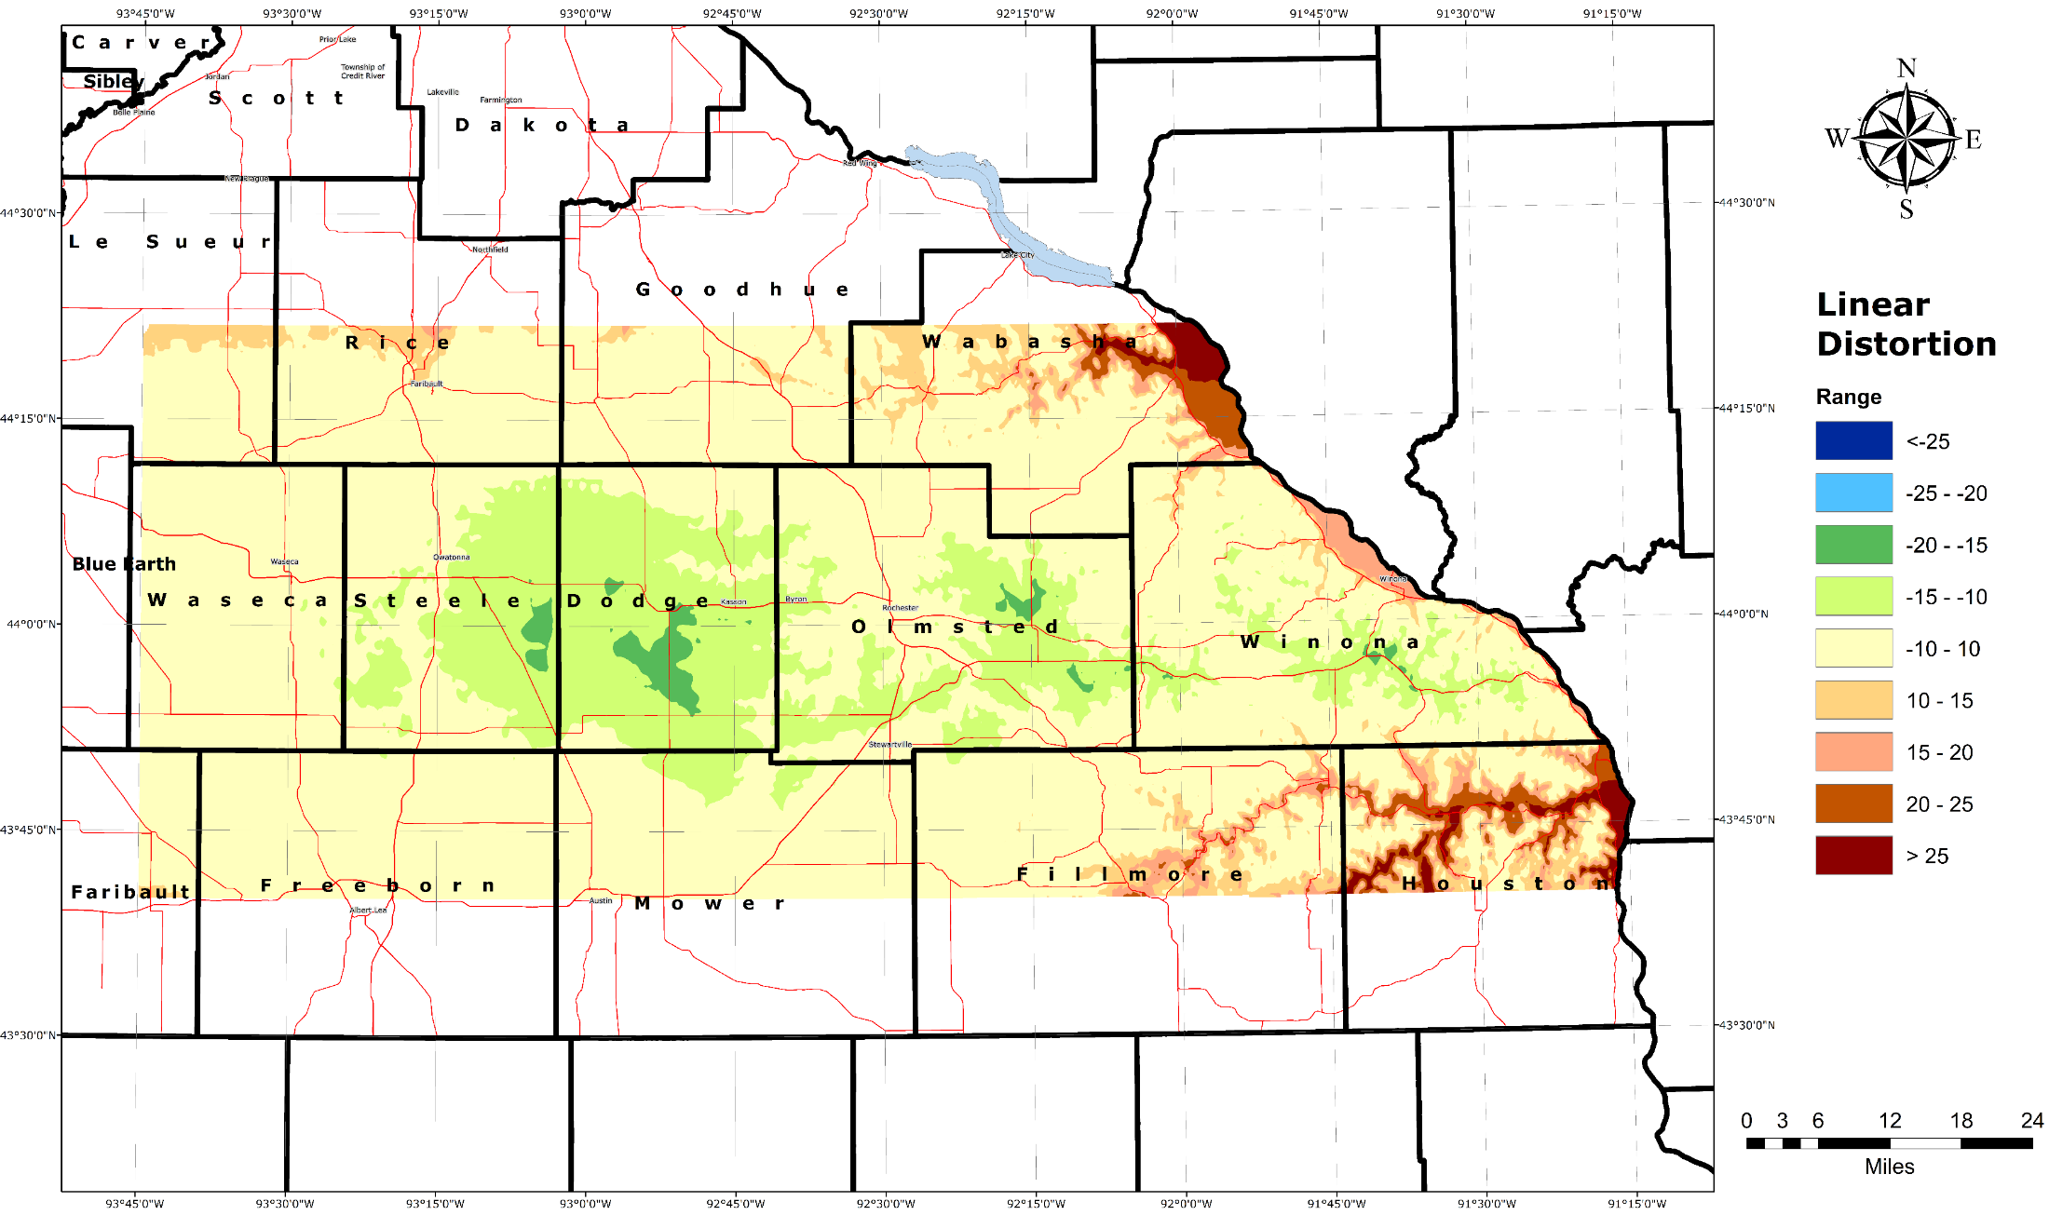
Steele, Dodge, Olmsted, Winona

Slide 35
Freeborn, Mower, Fillmore, Houston

