Slide 1
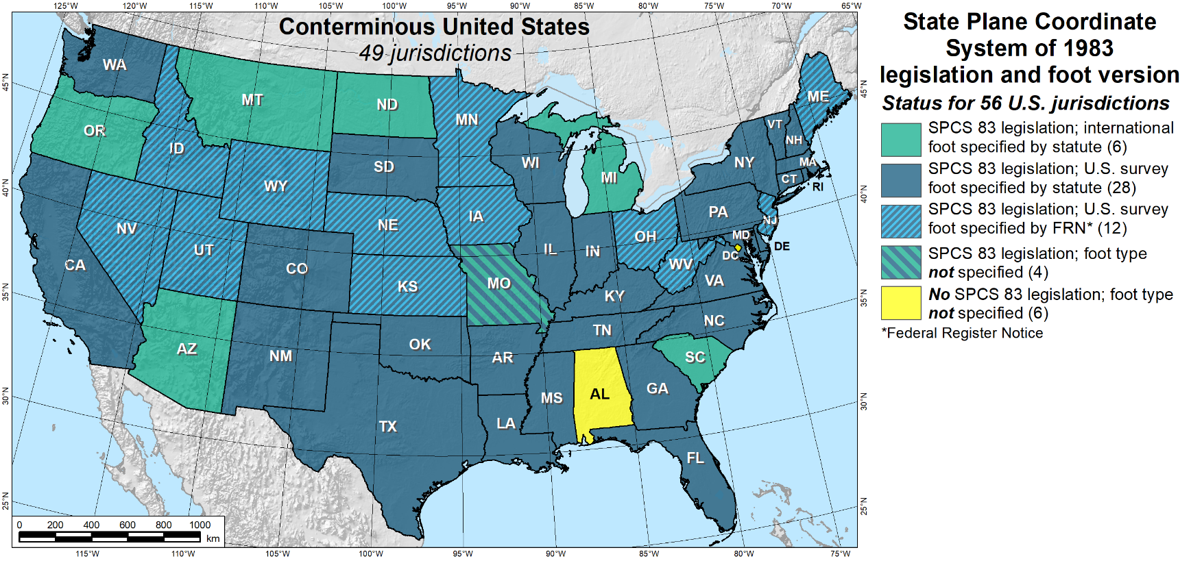
Deprecation of the US Survey Foot
Geoff Bitner, LS
MnDOT Office of Land Management
NGS State Geodetic Coordinator
MACS Land Surveying Seminar
October 22, 2021 | St. Cloud, MN

Slide 2
End of the US Survey Foot
International ft ≈0.01ft shorter per mile (≈2ppm)
In 1959 the foot defined as 1ft = 0.3048m exactly
Exception made for: “… feet derived from and published as a result of geodetic surveys within the United States will continue to bear the following relationship…”
1 foot = 1200/3937 meter
Intended as temporary solution, supposed to switch to new foot with readjustment of “basic geodetic survey networks”

Slide 3
Authority and Effective Date
U.S. Constitution; Article I, Section 8, Clause 5
“The Congress shall have power to … fix the standard of weights and measures”
The National Institute of Standards and Technology (NIST) along with the National Geodetic Survey (NGS/NOS/NOAA) are taking collaborative action to provide national uniformity in the measurement of length.
Effective deprecate date of the “U.S. survey foot” will be December 31, 2022. After that the “U.S. survey foot” will be superseded by the “foot” (formerly known as the “international foot”)

Slide 4
Relative Distance vs Coordinates
Distance Between Points isn’t the Problem
Difference between International Ft and US Survey Ft is approximately 0.01ft per mile
In 10 miles the difference would be ≈ 0.10ft
Coordinate System Grid Positions is the Difference
If you’re working in a coordinate system with large numbers… like State Plane…
A northing coordinate of 2,700,000 would be different by [(2,700,000/5280)*0.01] ≈ 5.11ft

Slide 5
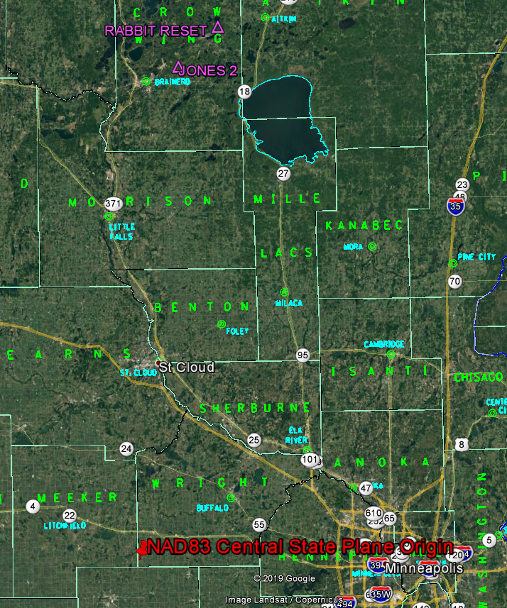
Origin of State Plane Central Zone
Located in the SW corner of Wright county
False N = 100,000m
False E = 800,000m

Slide 6
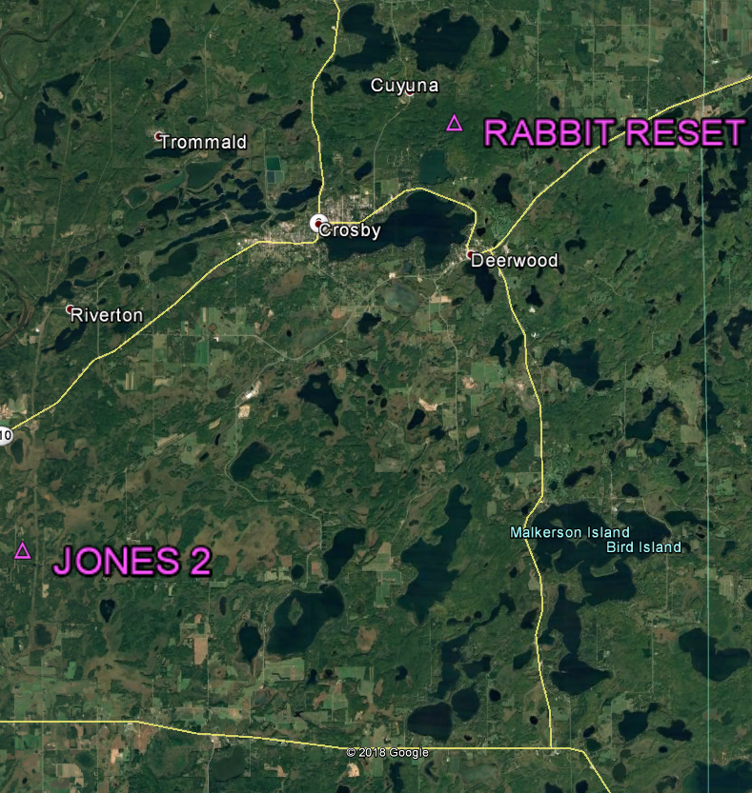
US Survey vs International Foot Grid Differences
Inversed difference between US Survey feet and International feet is ≈0.11ft over 11 miles
+/- 11 miles

Slide 7
US Survey vs International Foot Grid Differences
The difference in grid positions is about 5.65ft (US and INT)
+/- 11 miles

Slide 8
Summary
The “new” foot is ≈0.01ft shorter per mile (≈2ppm)
Effective date will be December 31, 2022 and will sort of coincide with the new datum
It’s a grid problem not a distance problem

Slide 9
Questions?
Geoff Bitner, LS
geoffrey.bitner@state.mn.us

